Slide 1
Results from Biostat Global Simulation of UCLA-KSPH Sampling Plans
Simulation 1
April 15, 2023
www.biostatglobal.com

Slide 2
Context
This slide deck is meant to accompany a memo that describes the simulation motivation, methods and results.
Each slide shows output from a single simulation run.
These data were inspired by analyzing the distribution of two outcomes: fully vaccinated child and zero dose child in two different surveys where I have district level survey data with 20 or more clusters per survey.
One survey was from Pakistan in 2022 and the other was from Burkina Faso in 2016.
These analyses ignore survey weights.
In each figure that follows:
The distribution of the binary outcome across clusters in a stratum is shown in the figure at the left side of the slide.
That is an organ pipe plot.
It has one column per survey cluster.
The colored portion of the cluster indicates the % of respondents who had the binary outcome of interest.
The shaded portion of the figure indicates the % of respondents in the entire stratum who had the outcome of interest.
These data have been adjusted slightly from their original form (and sometimes from their original values).
The retain the essential features of the survey data.

Slide 3
Confidence interval plots (right-side)
The results of 100 sample draws appear at the right side of each figure.
The target population coverage figure is shown with a dark red vertical line.
Confidence intervals are plotted for twenty samples from each of five sampling plans.
The top plan is a simple random sample of N=103 respondents.
The other plans, moving down the plot, are cluster sampling plans with 41, 20, 10, and 5 clusters per sample, respectively.
If the 2-sided 95% logit confidence interval (CI) includes the target coverage value, the CI is colored gray.
If it excludes the target value, the 95% CI is colored red.
If the inner 2-sided 50% logit CI includes the target value, the 50% CI is colored green.
On average, we expect one red interval and ten green intervals for each set of 20 sample draws.
If the design effect of the sample is >1.5, the point estimate is colored red.
If the design effect is <= 1.5, the point estimate is colored black.
Within each sampling plan, the outcomes are sorted, bottom-to-top, in order of the lower bound of the 95% CI.
The text above each set of 20 intervals lists the sample size, the number of respondents per cluster, and the median, min, and max values of estimated coverage, design effect, effective sample size, and 95% CI half-width.

Slide 4
Duplicates Removed
Several redundant figures have been removed from the slide deck. When no one in the entire stratum has the outcome of interest, no one will have it in any sampling plans and the confidence intervals will be uniform within each sampling plan. We have removed duplicated instances where no one was zero dose in the entire stratum.

Slide 5
Data from Burkina Faso 2016
The following slides show simulation output for the outcome: Fully Vaccinated Child
This analysis is unweighted, so these data have been modified slightly to ignore survey weights and to each include 100 faux respondents per cluster. The data used for the simulation looks very much like that in the survey and retains all the important original features.

Slide 6
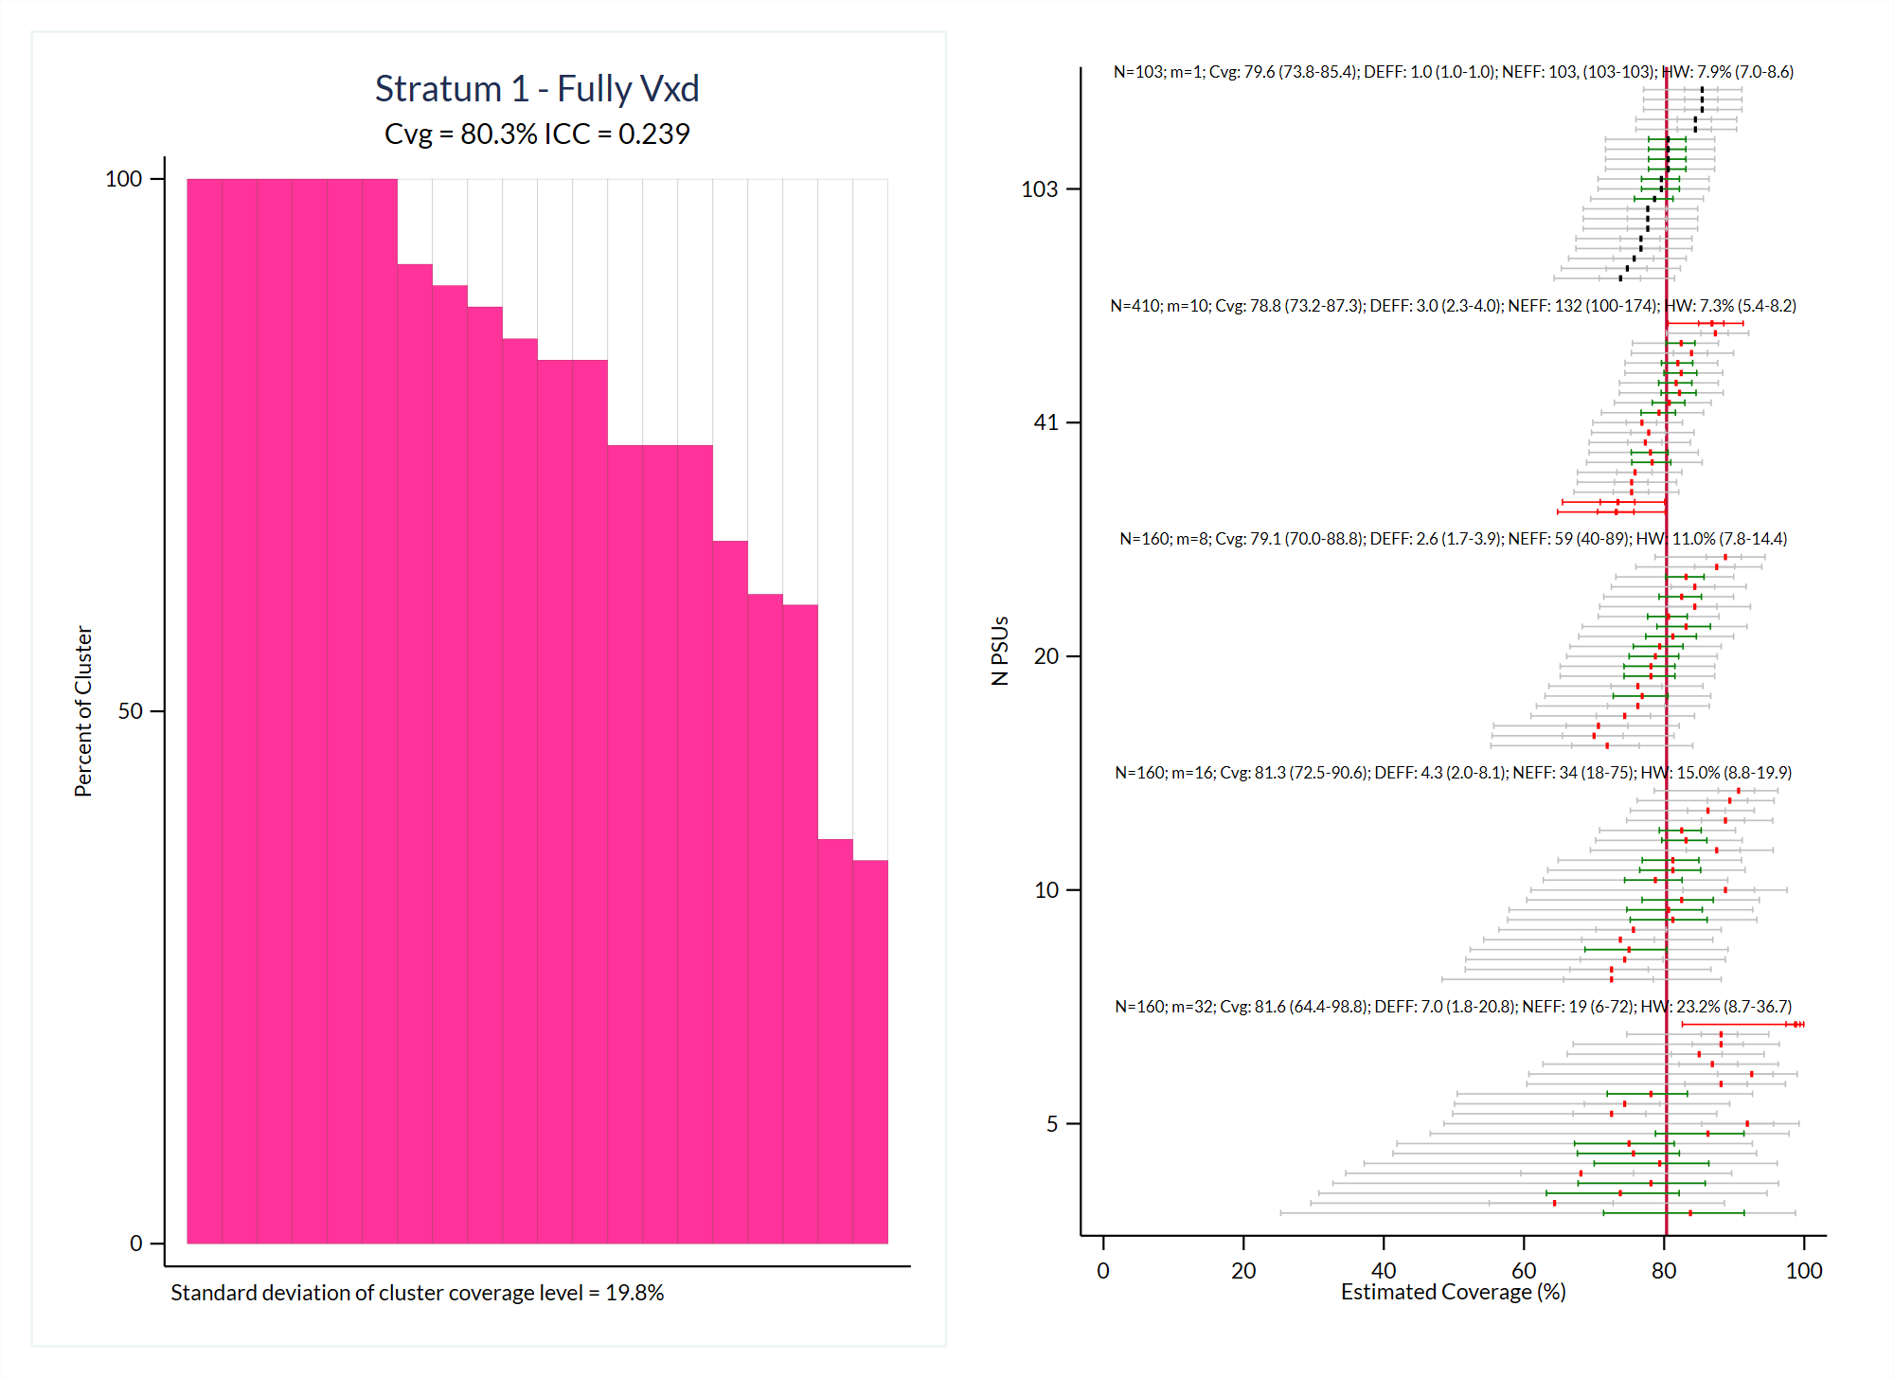

Slide 7
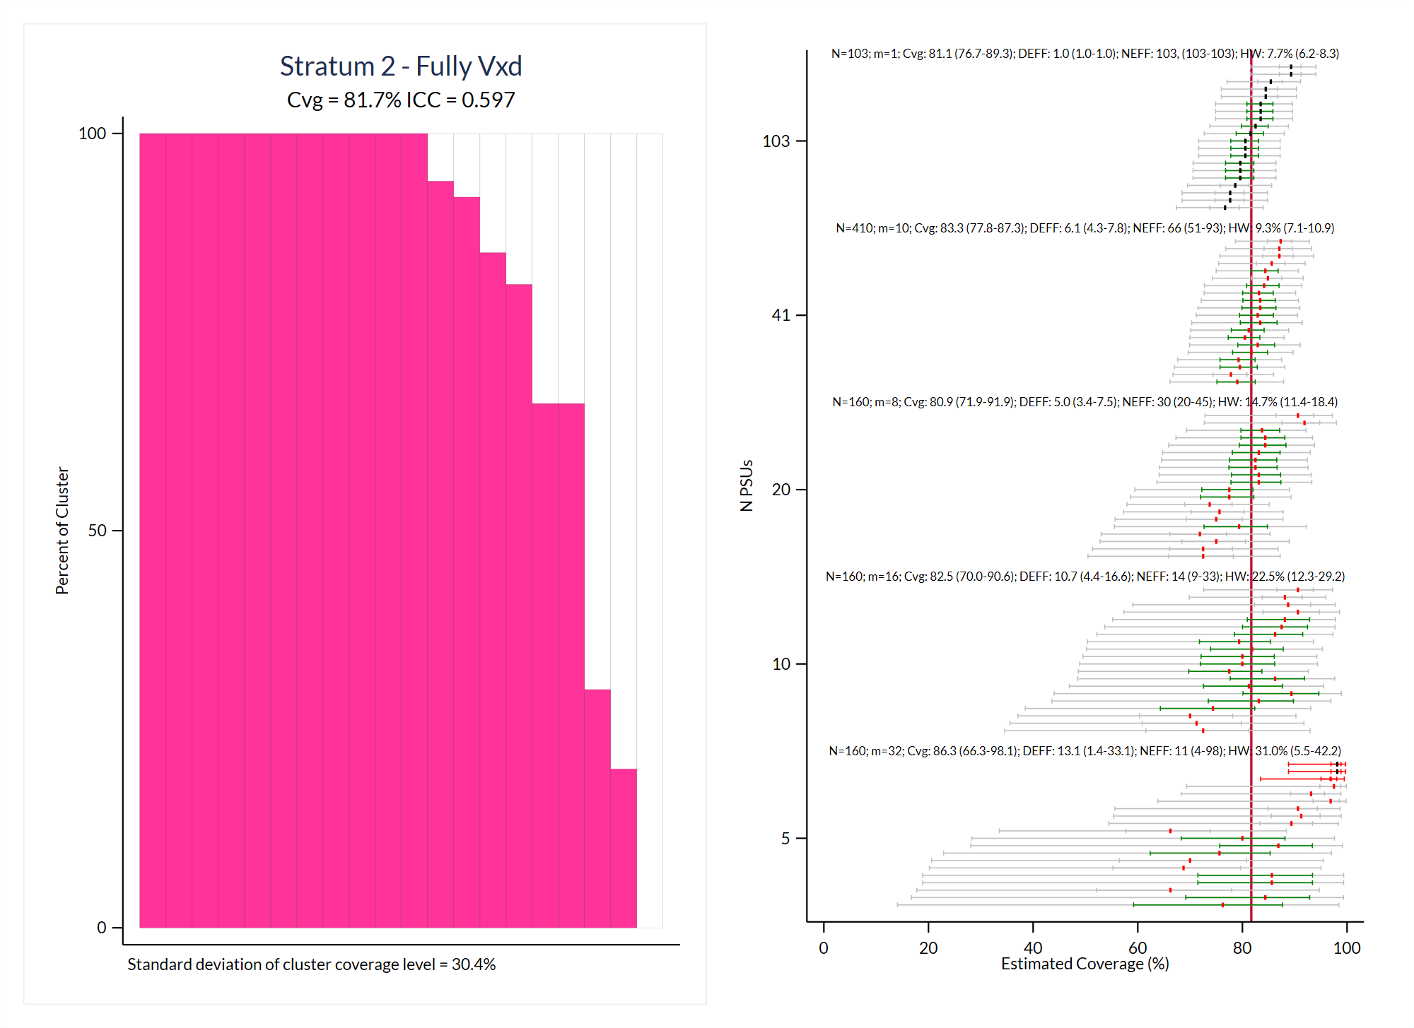

Slide 8
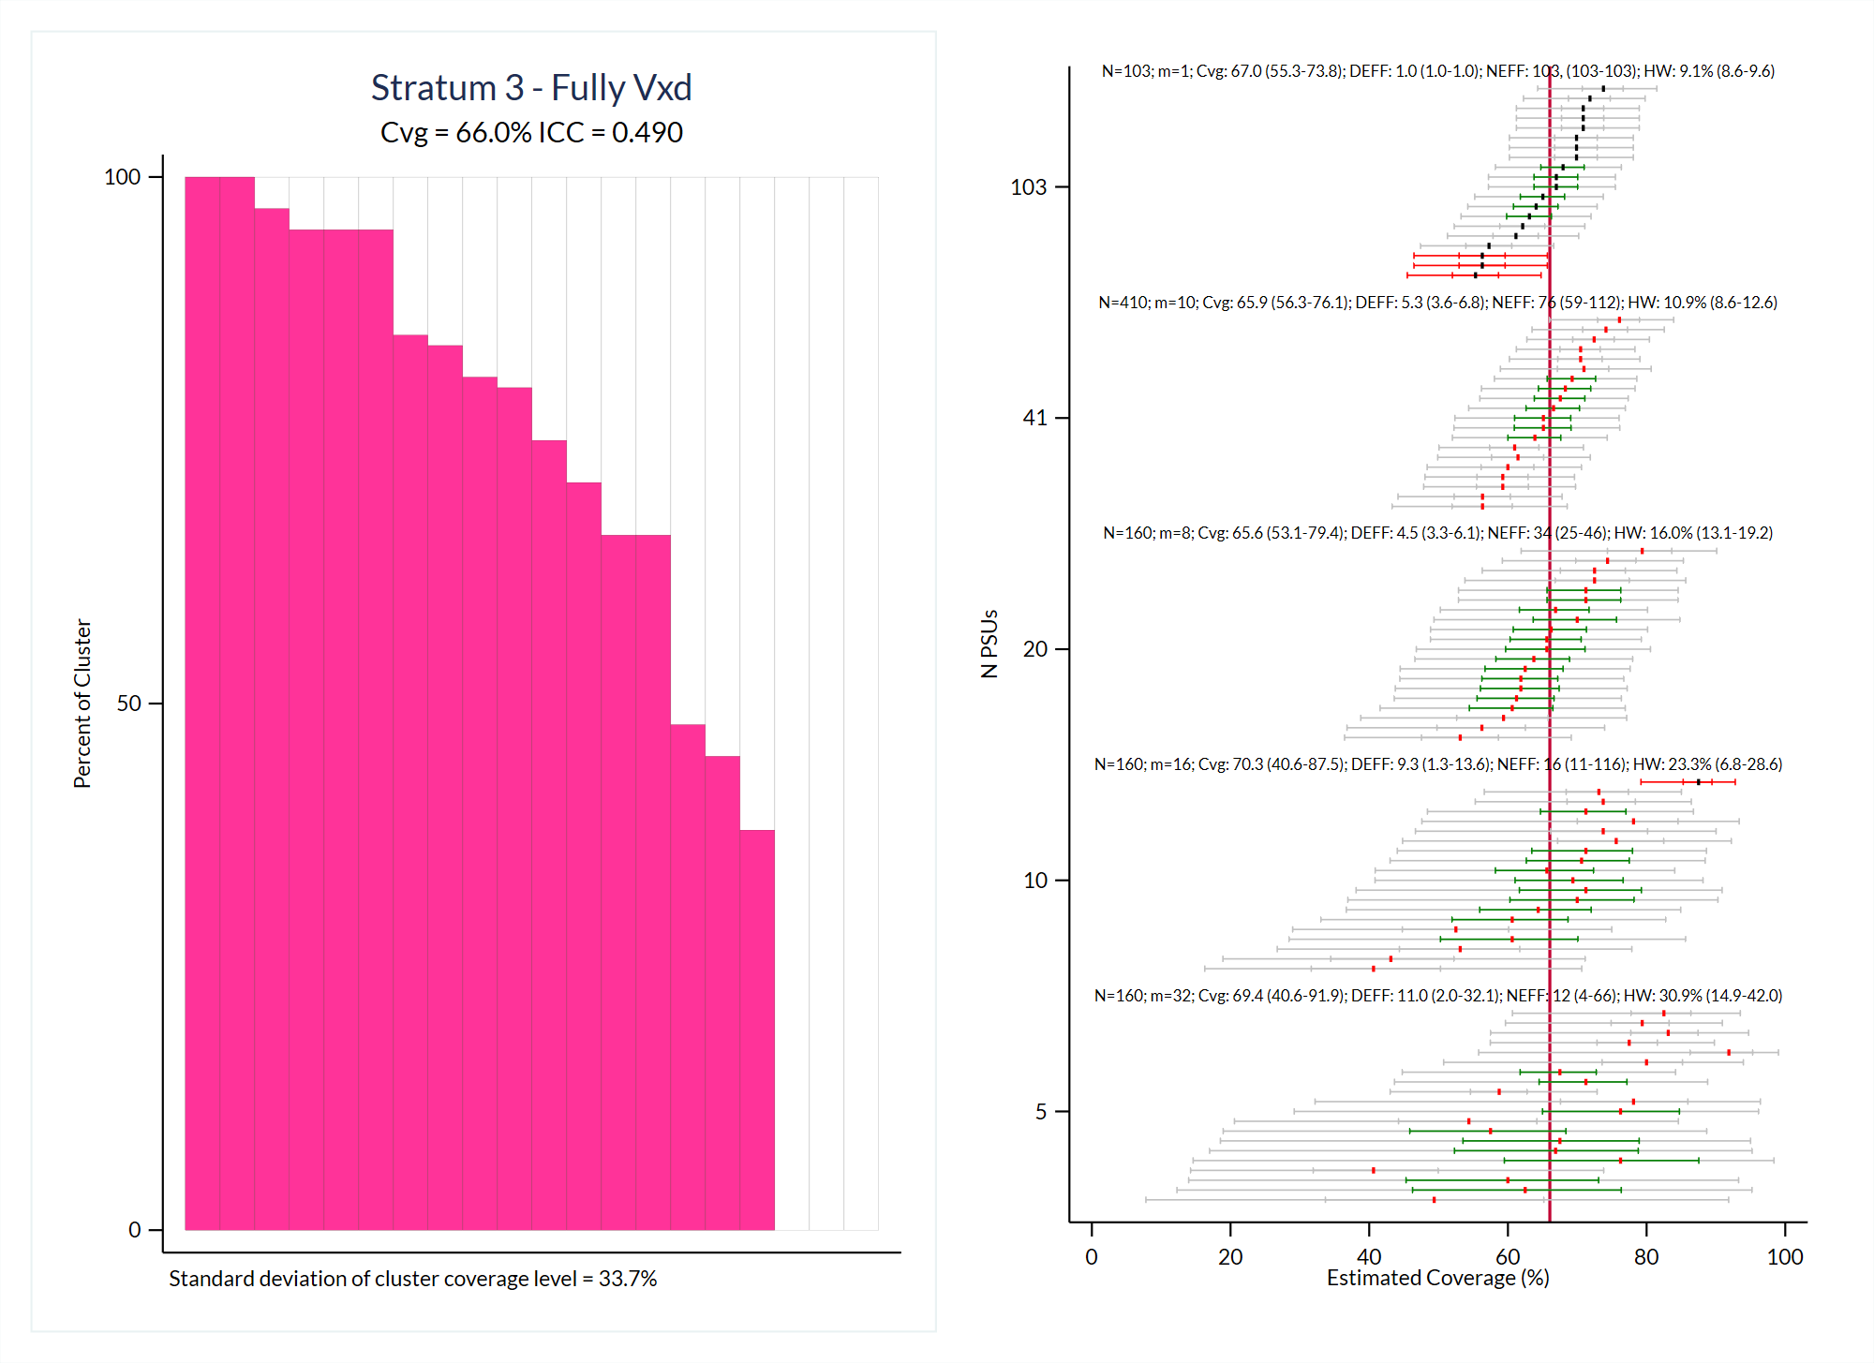

Slide 9
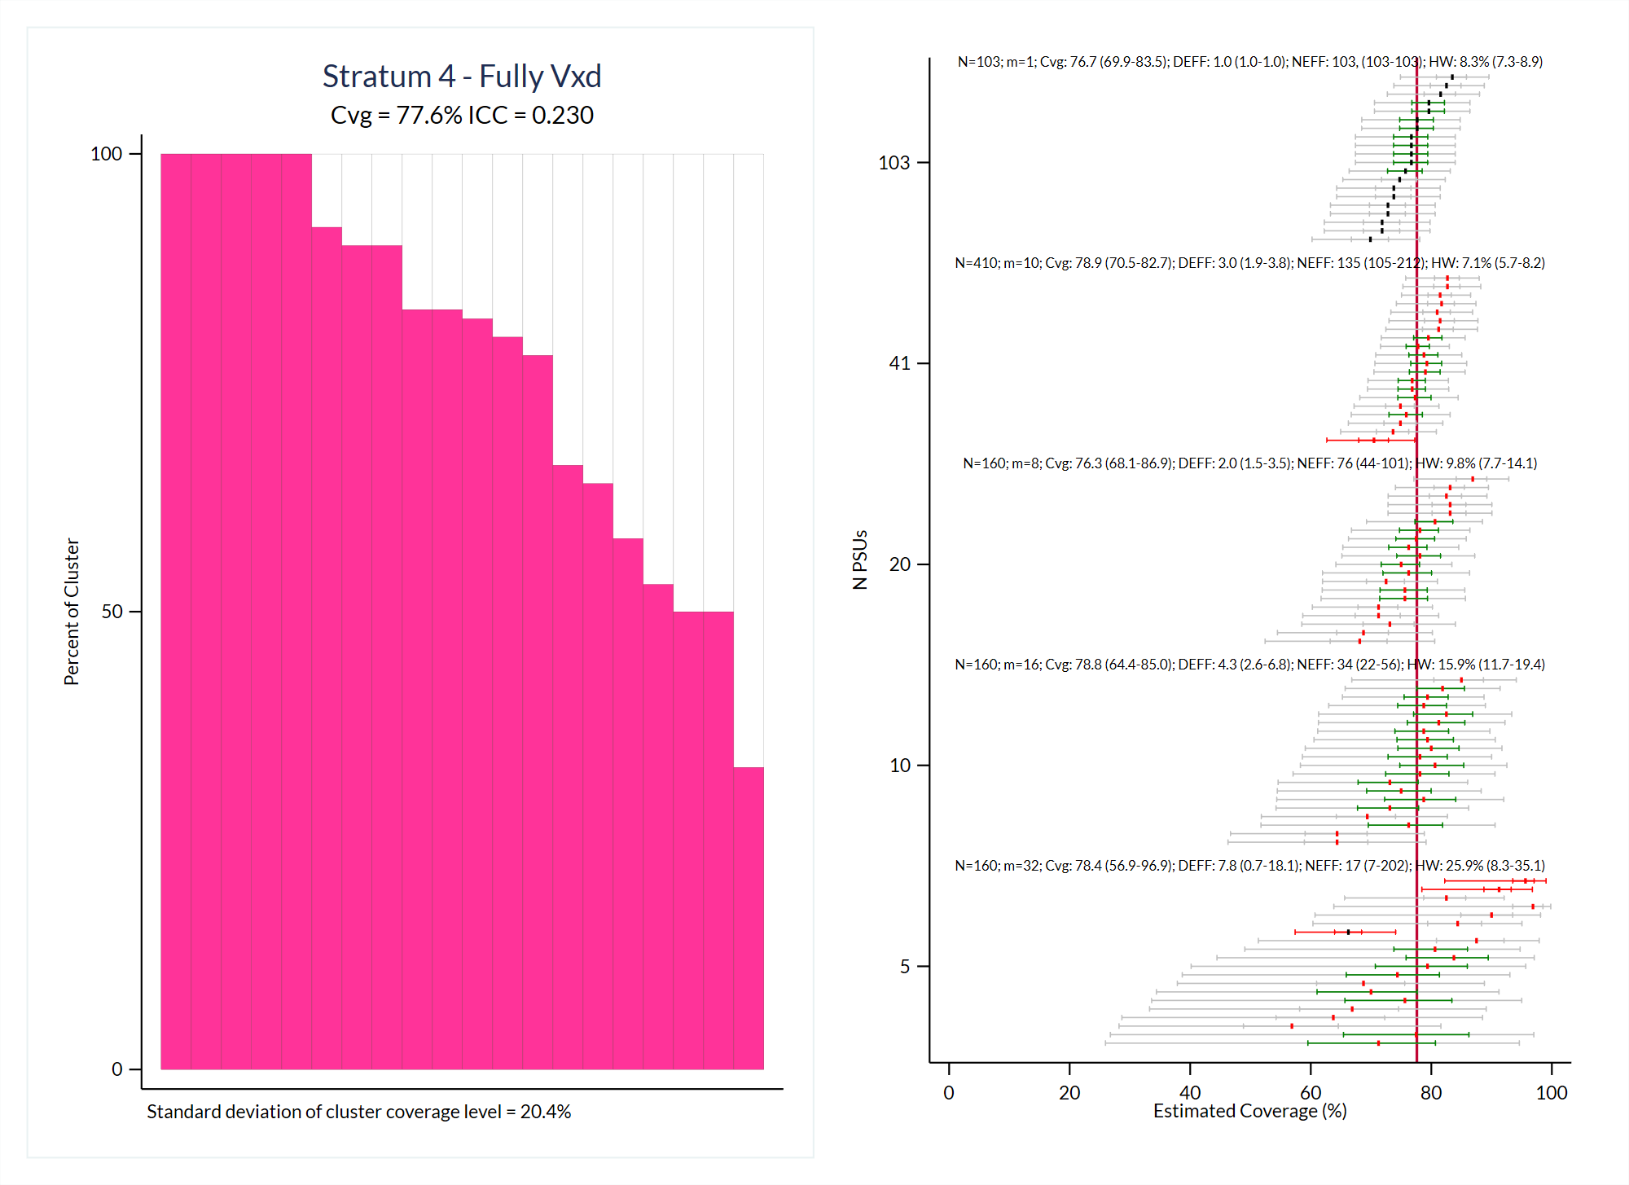

Slide 10
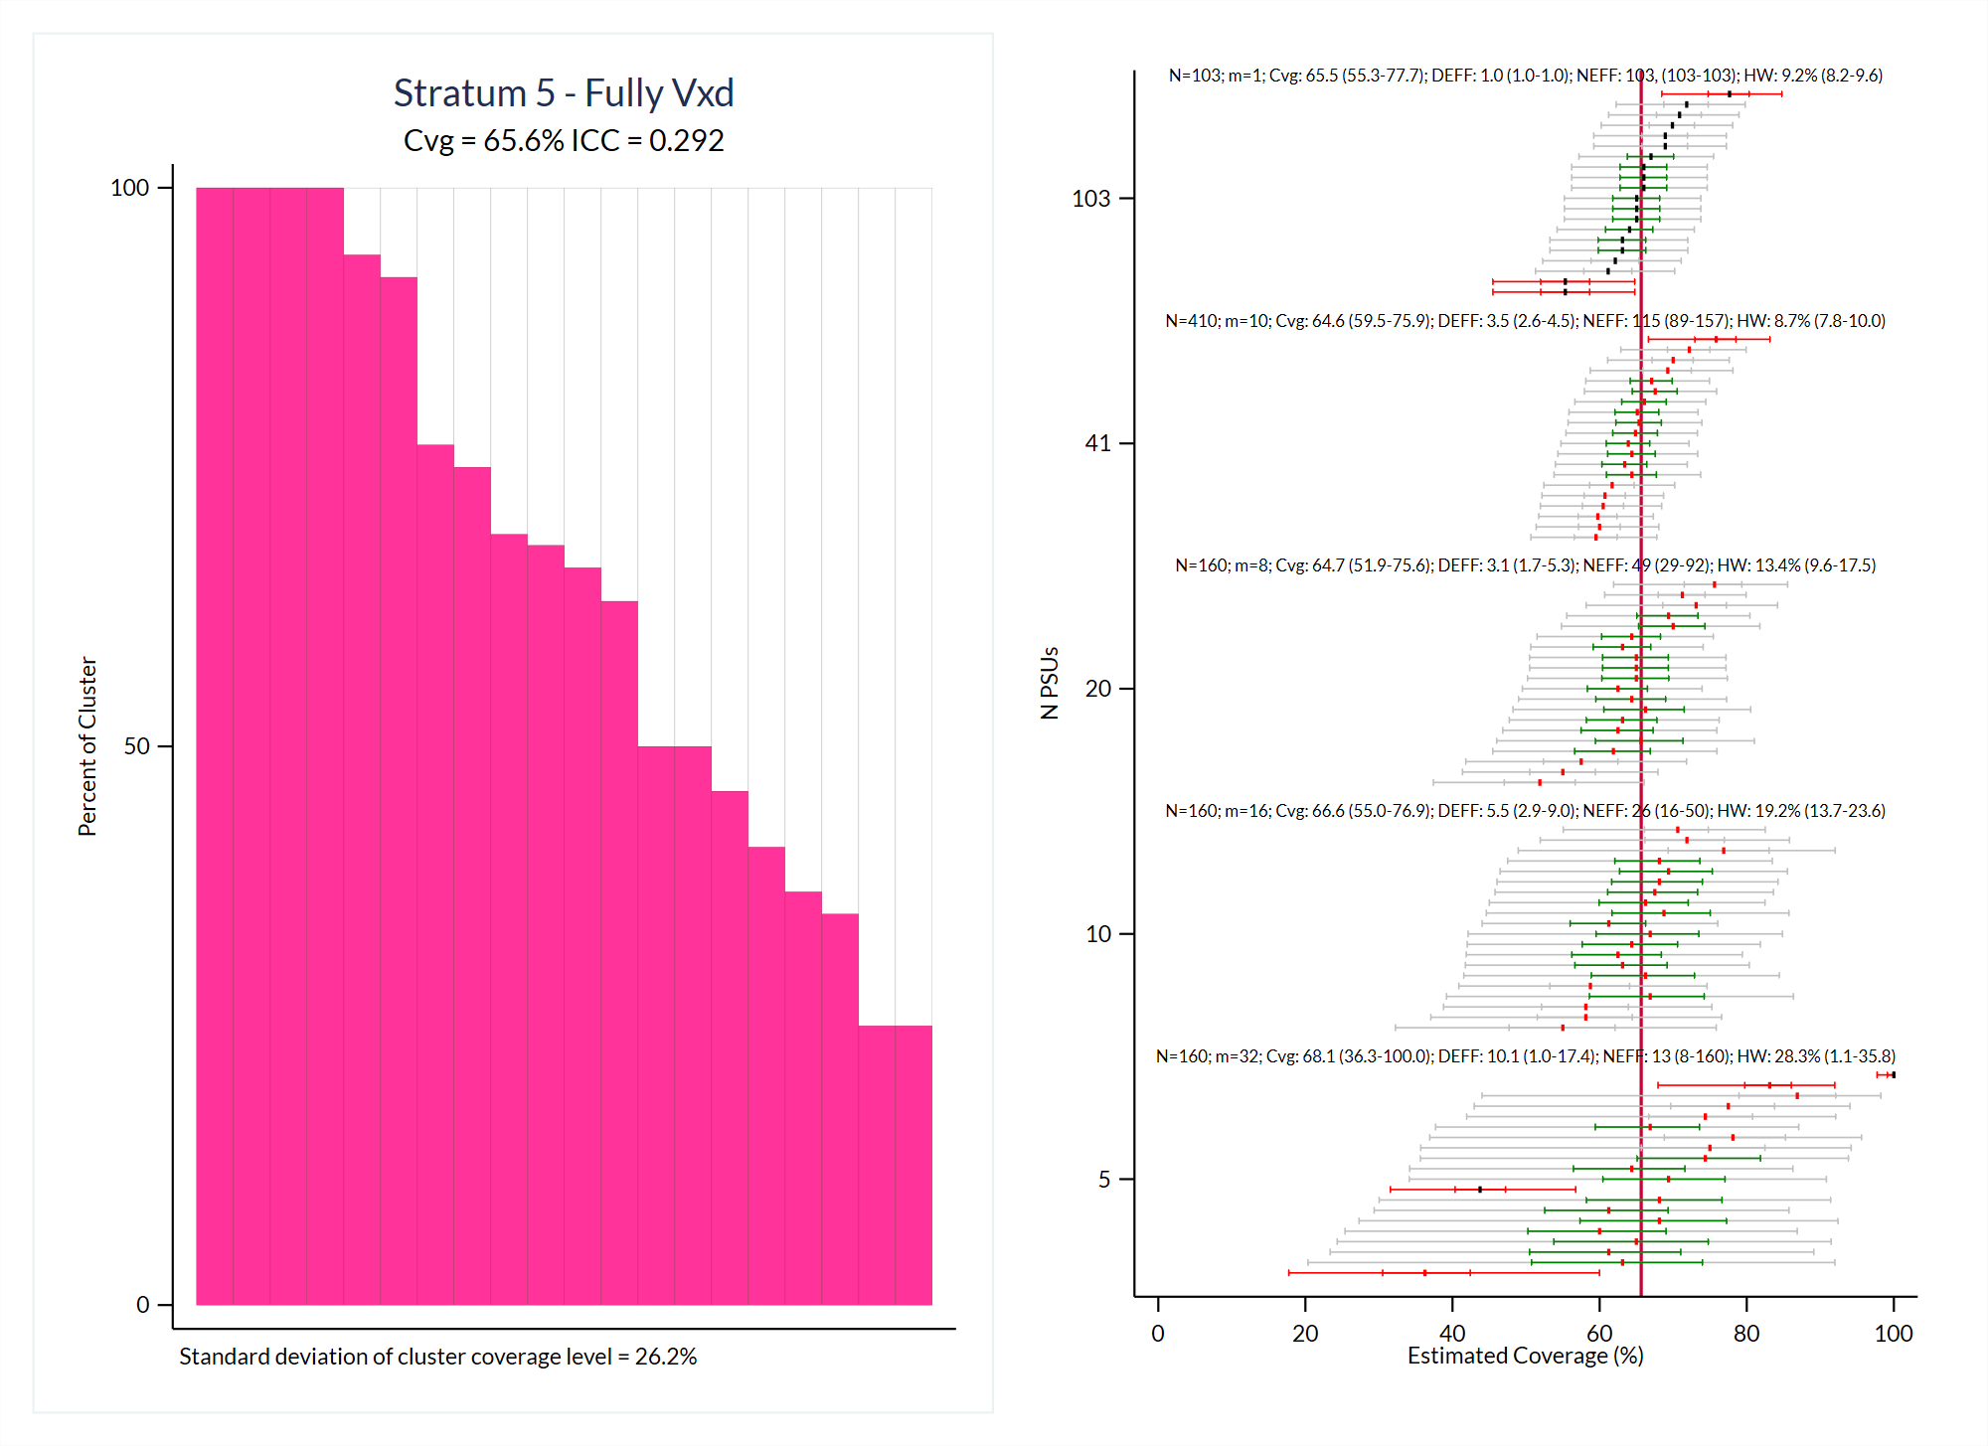

Slide 11
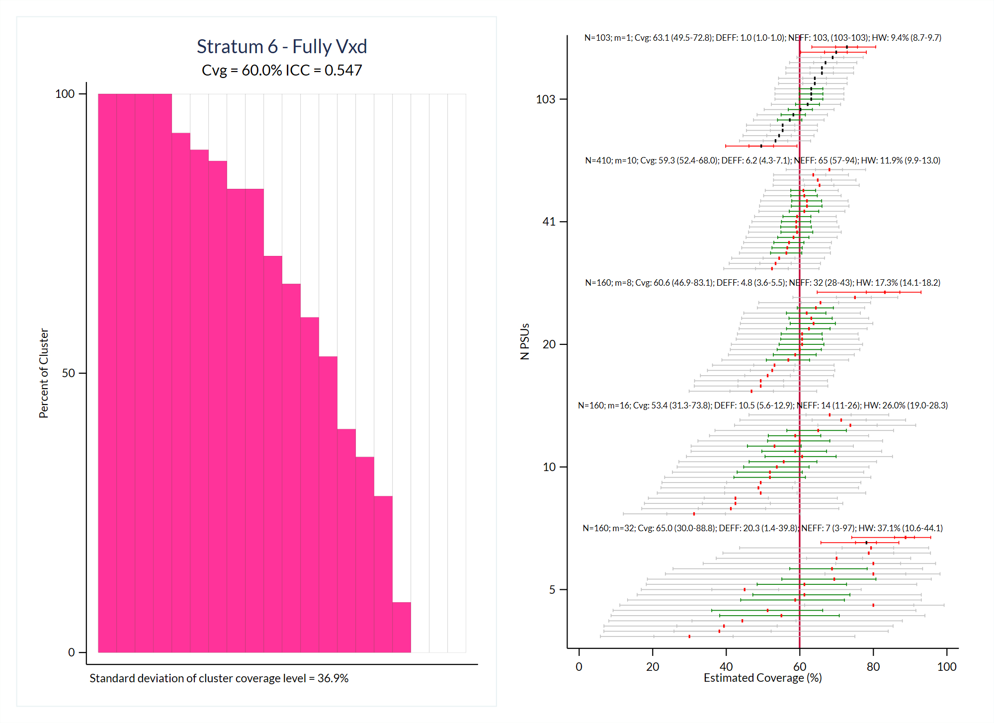

Slide 12
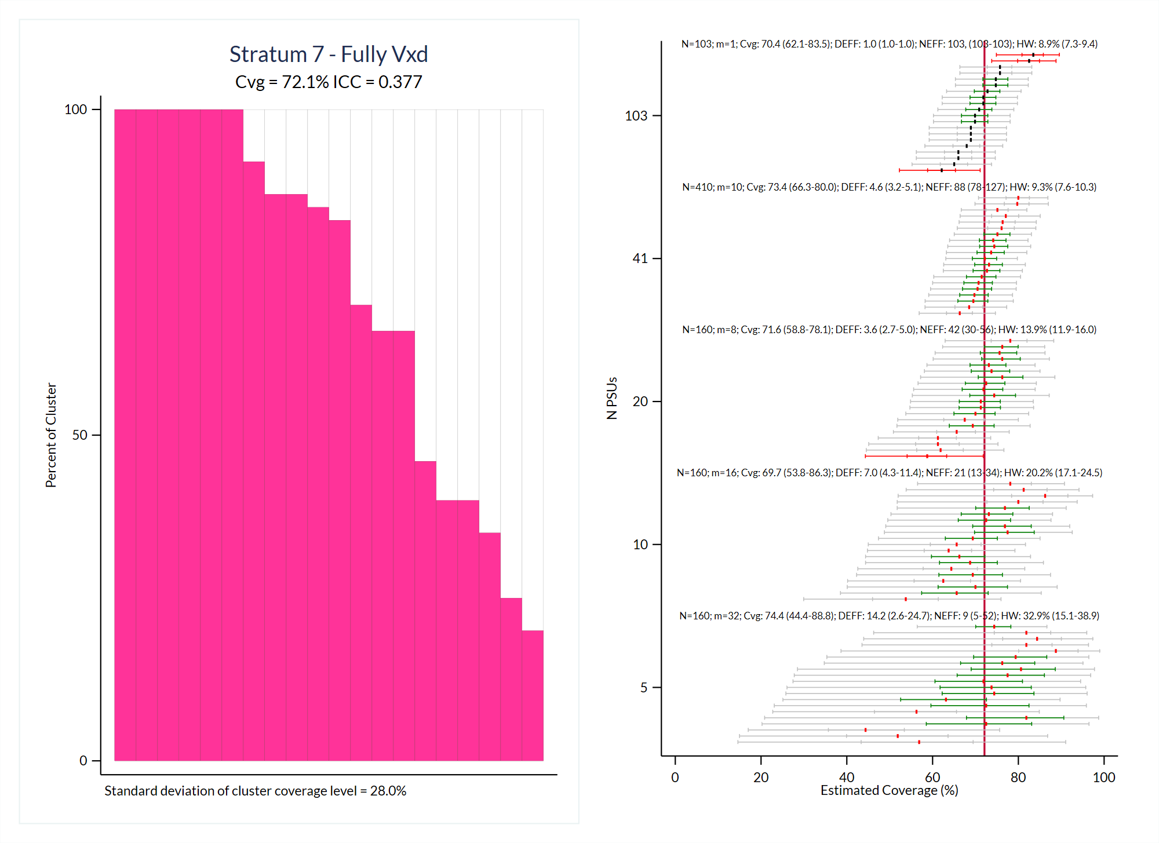

Slide 13
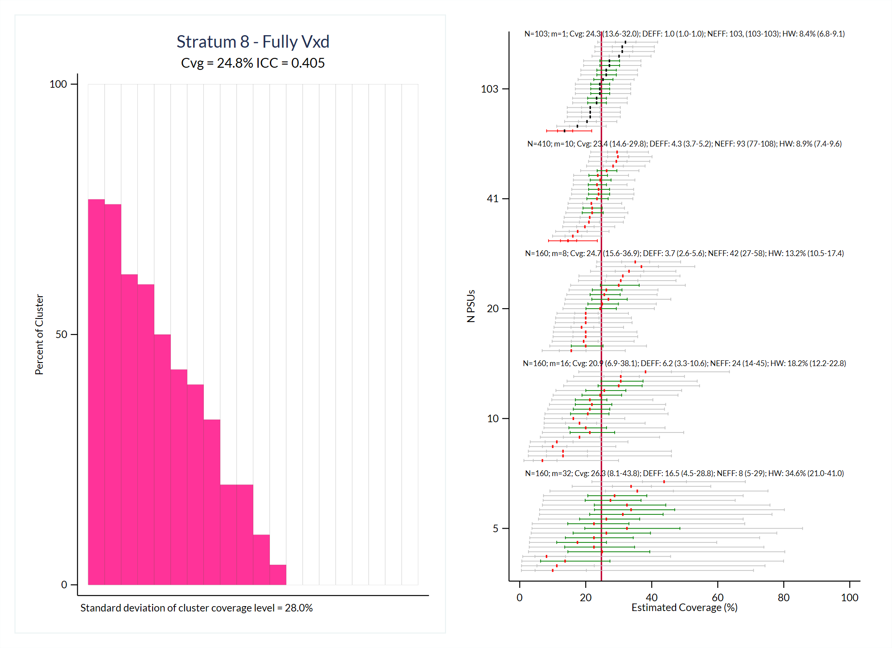

Slide 14
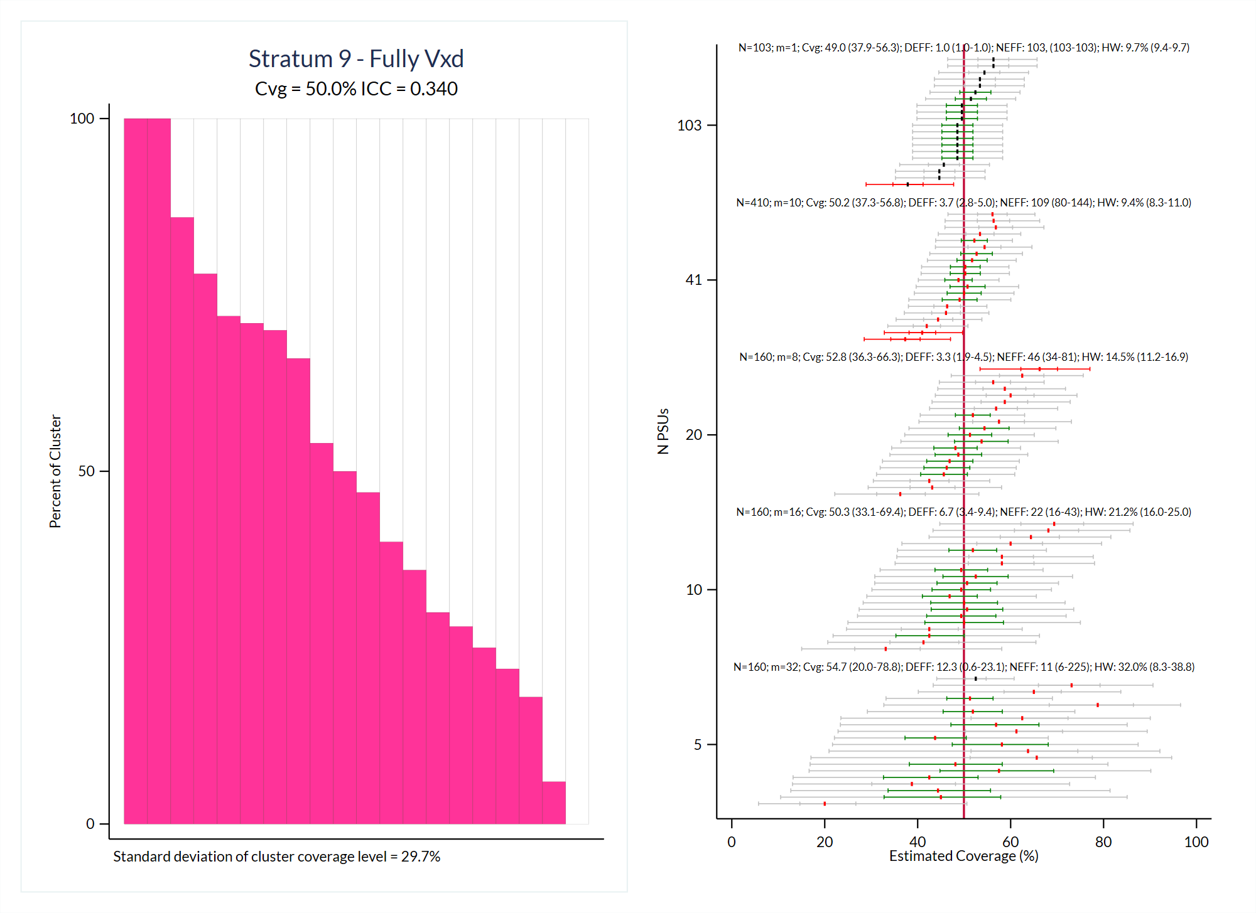

Slide 15
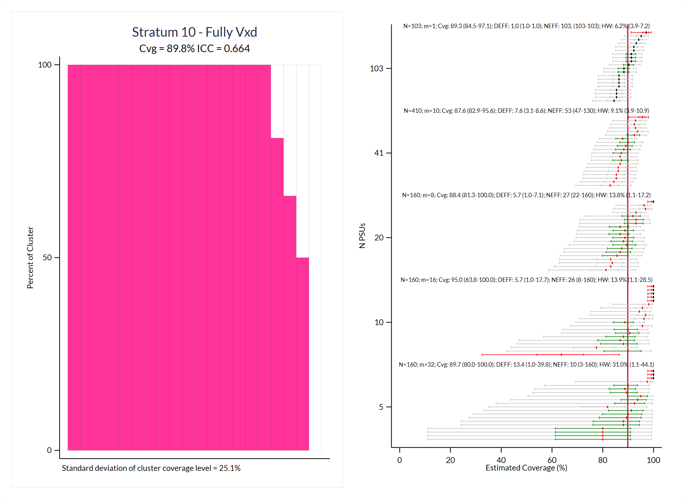

Slide 16
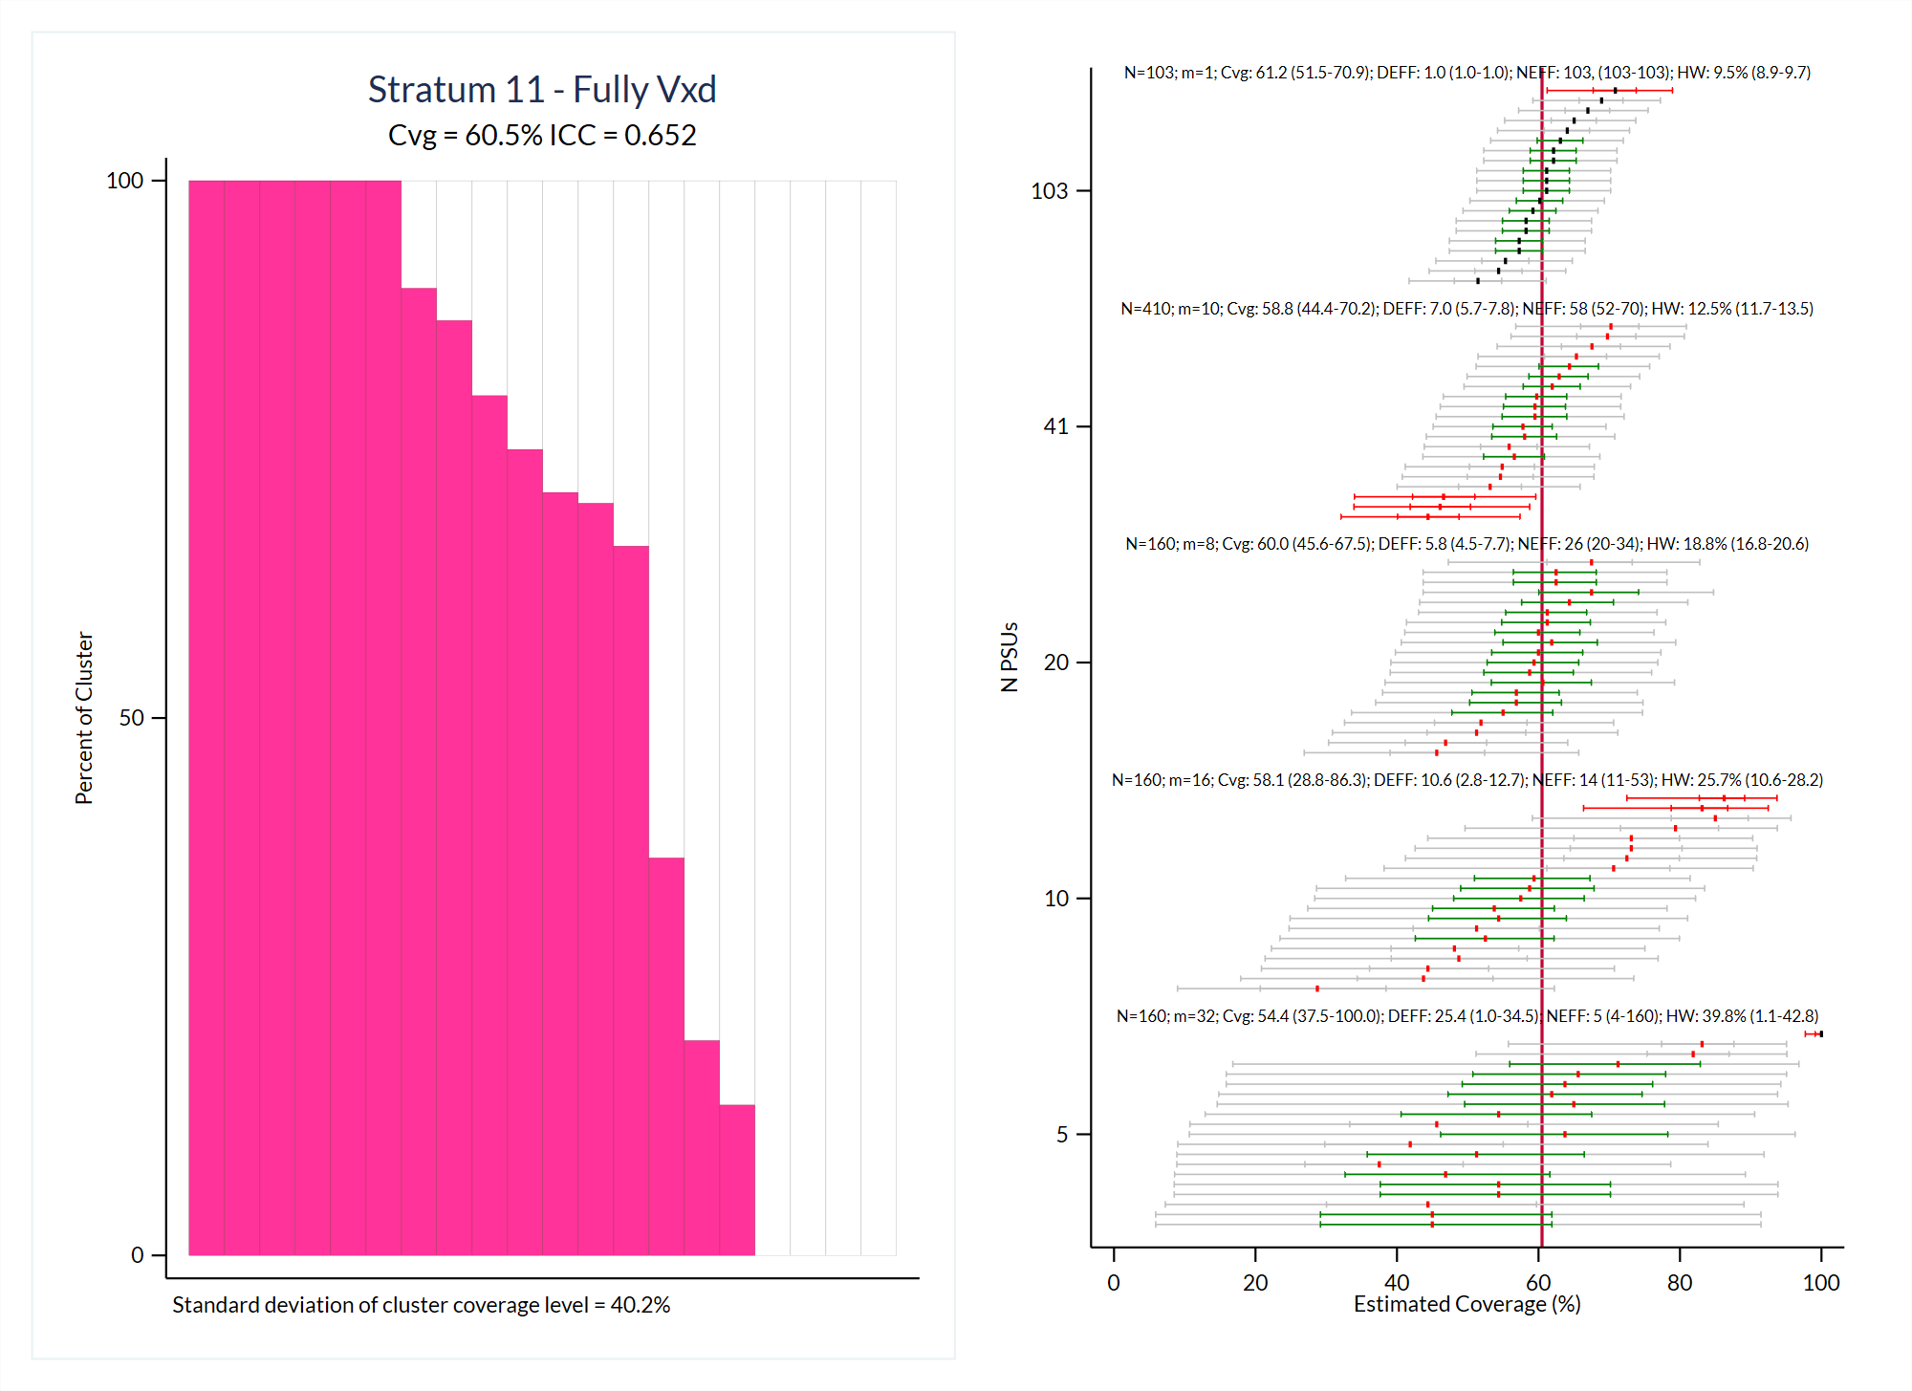

Slide 17
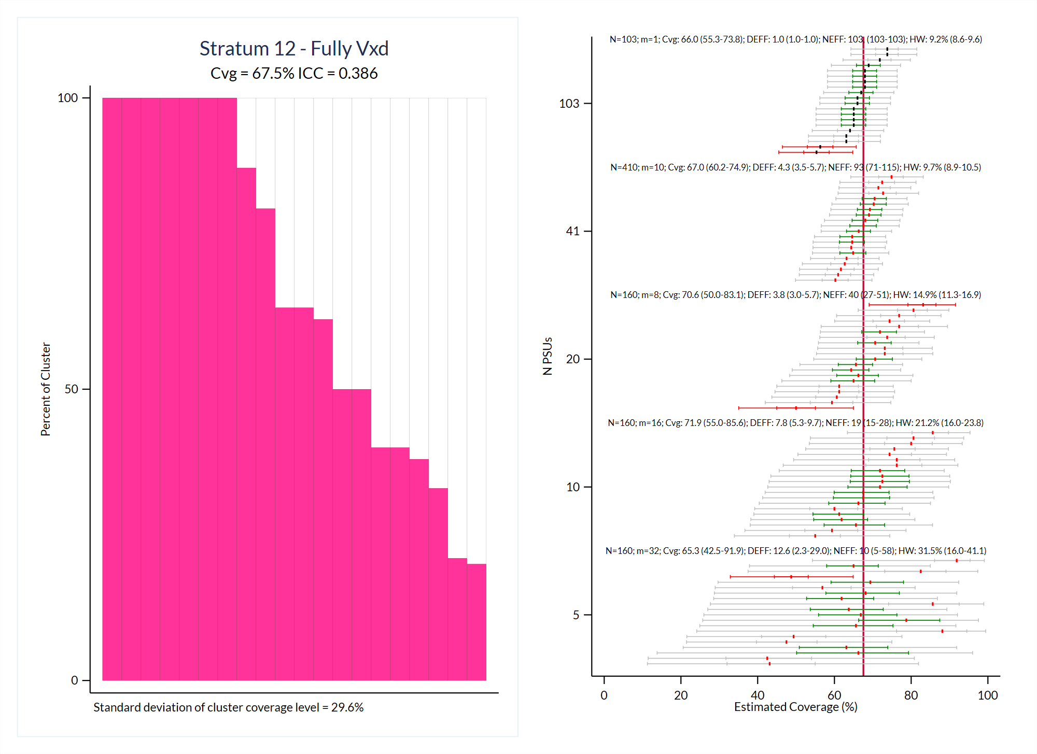

Slide 18
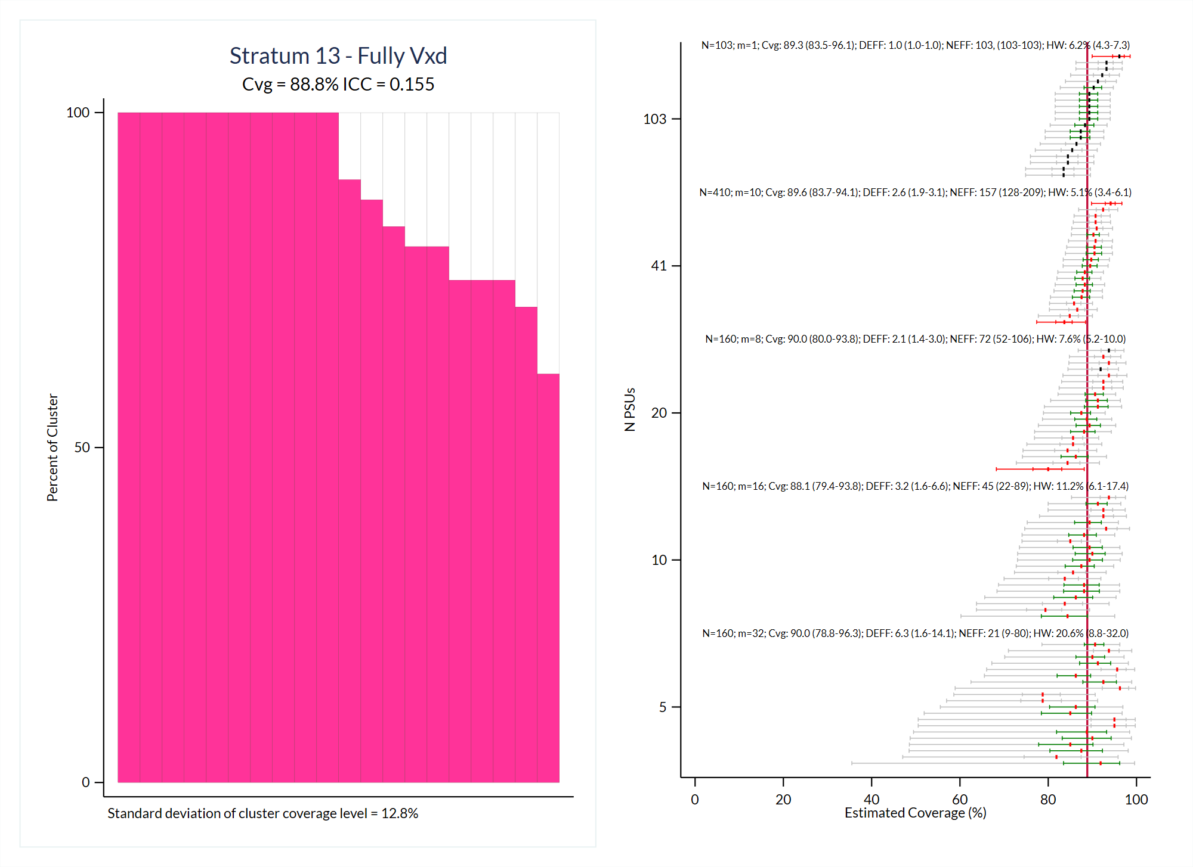

Slide 19
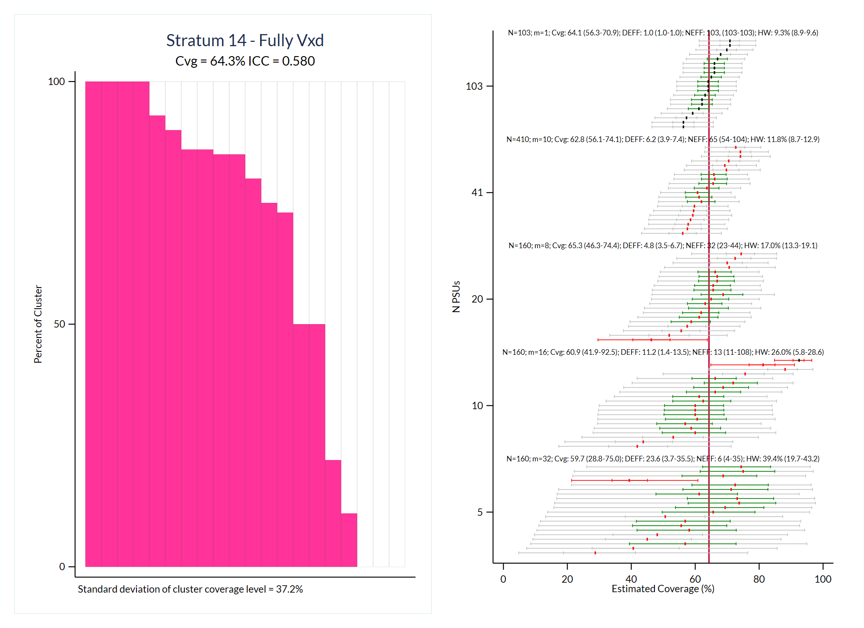

Slide 20
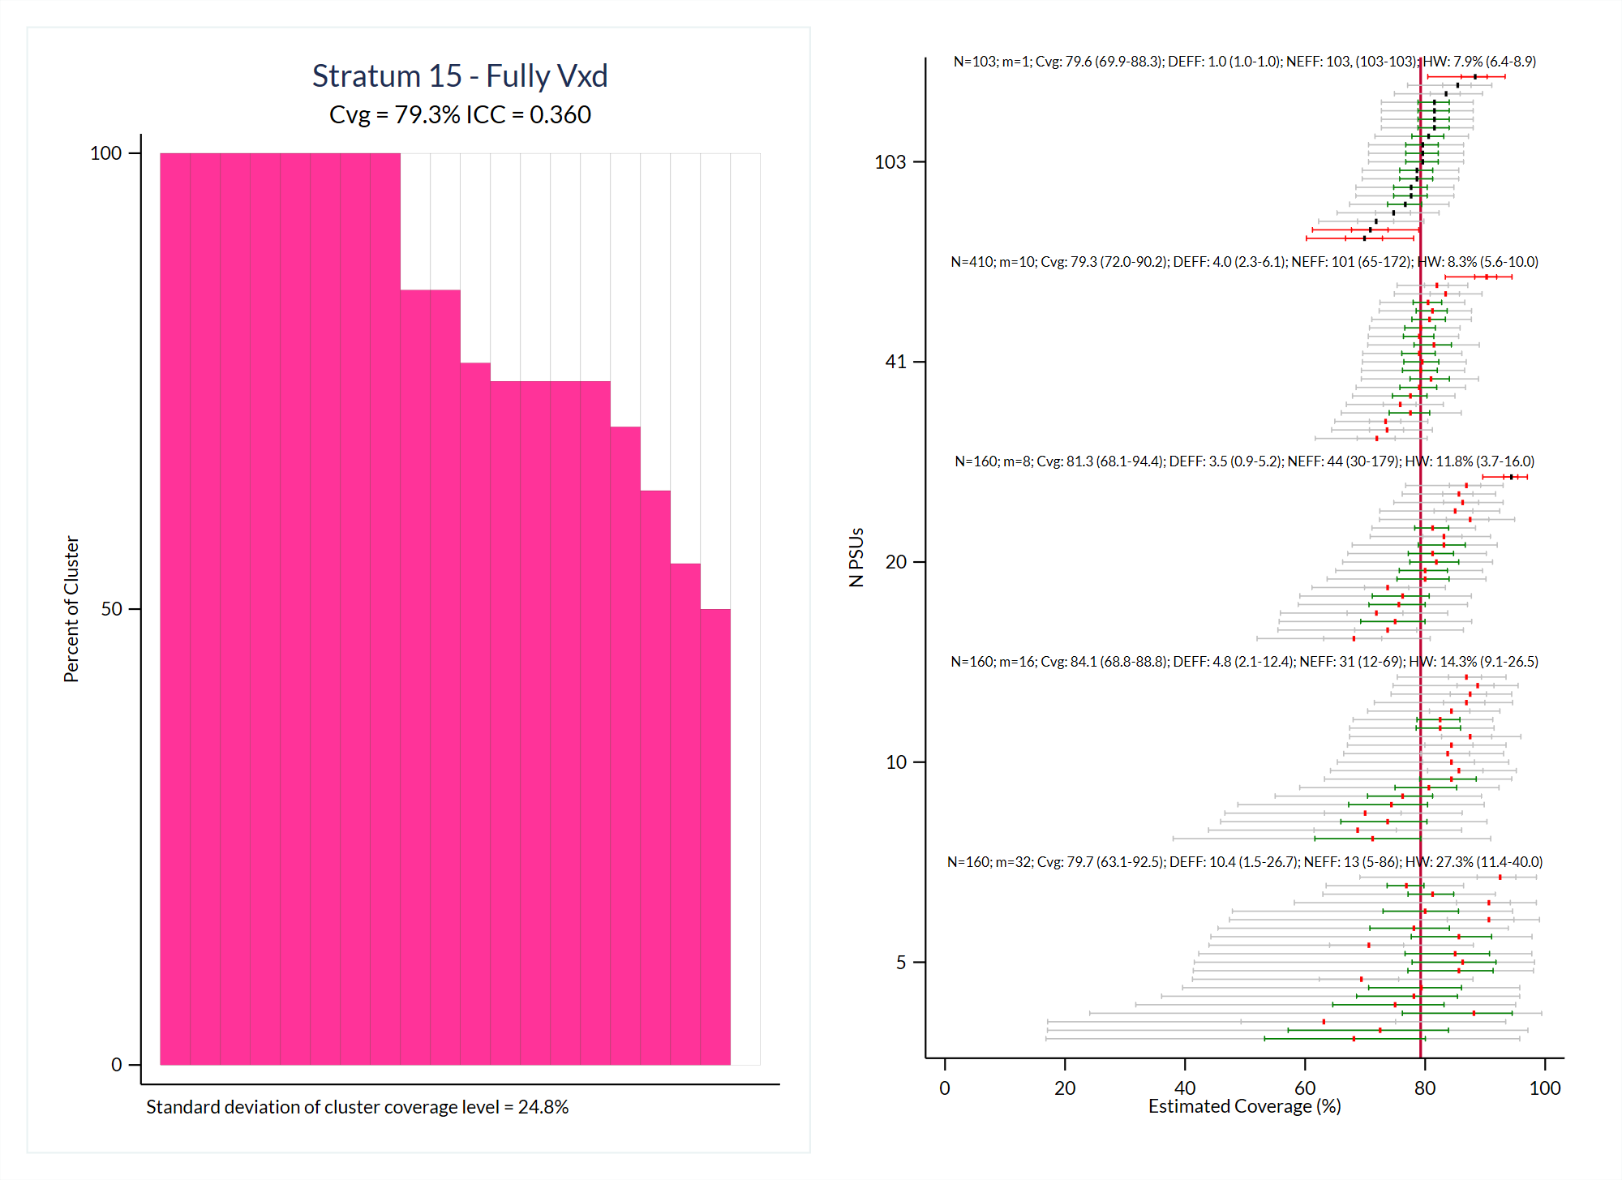

Slide 21
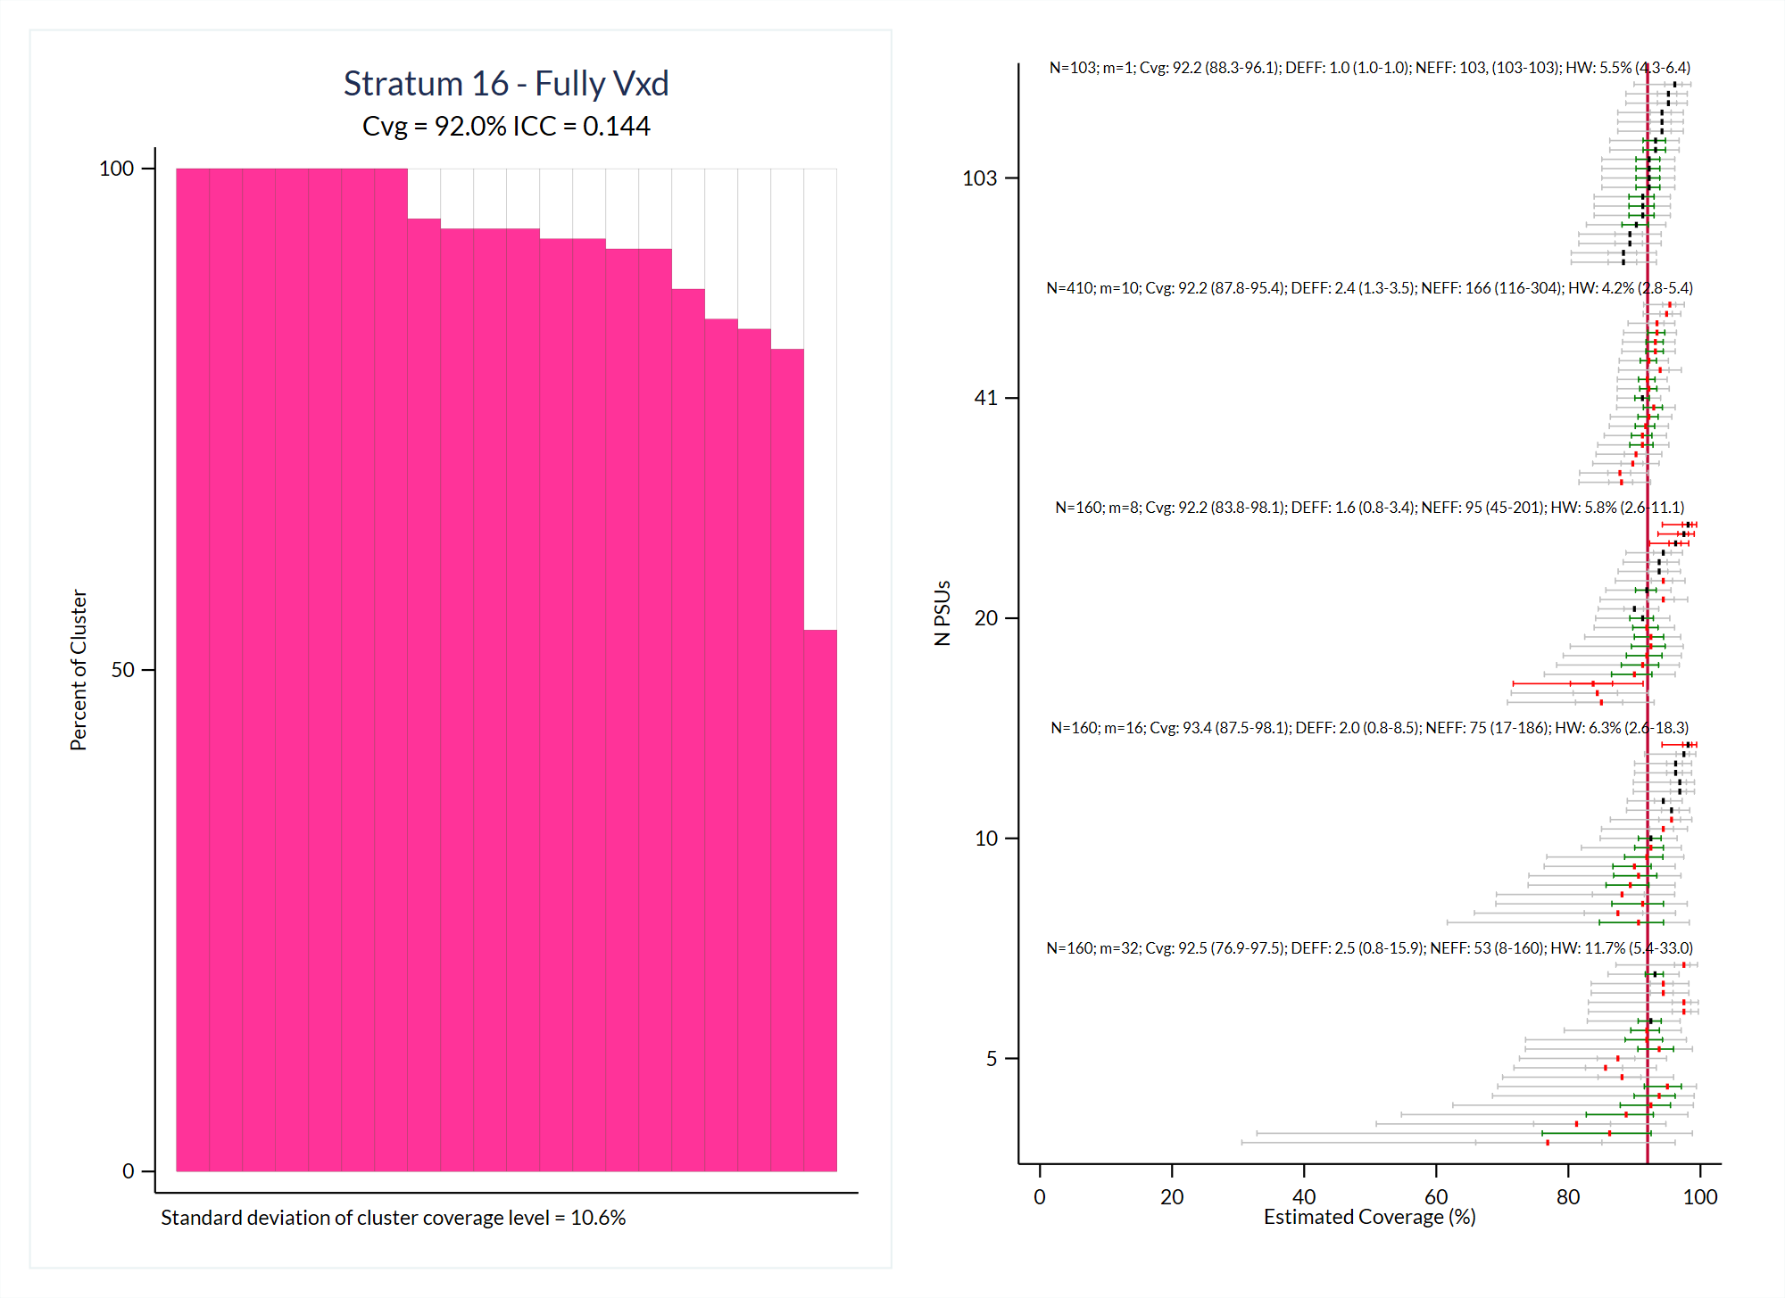

Slide 22
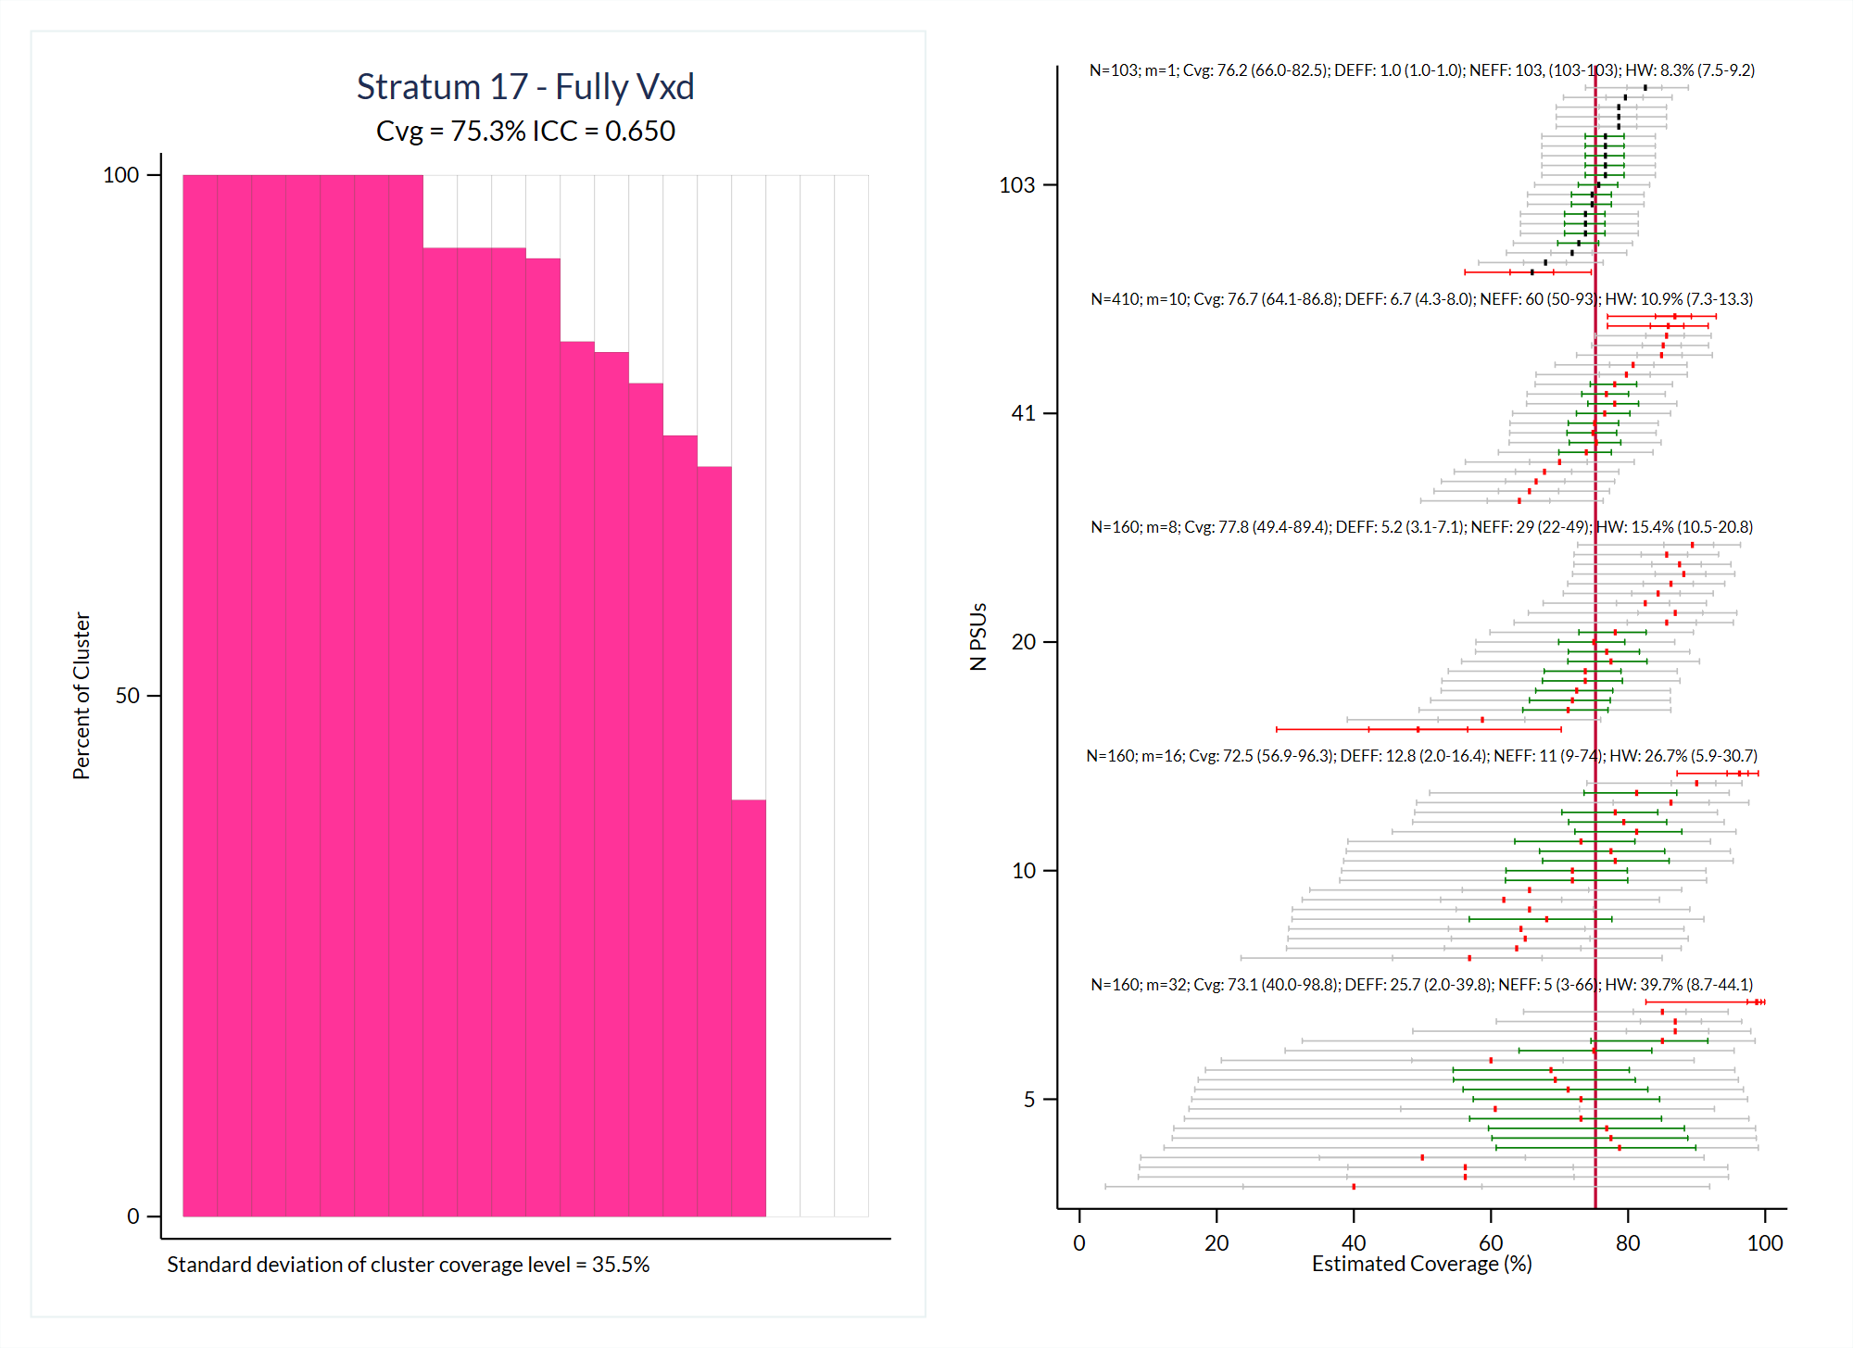

Slide 23
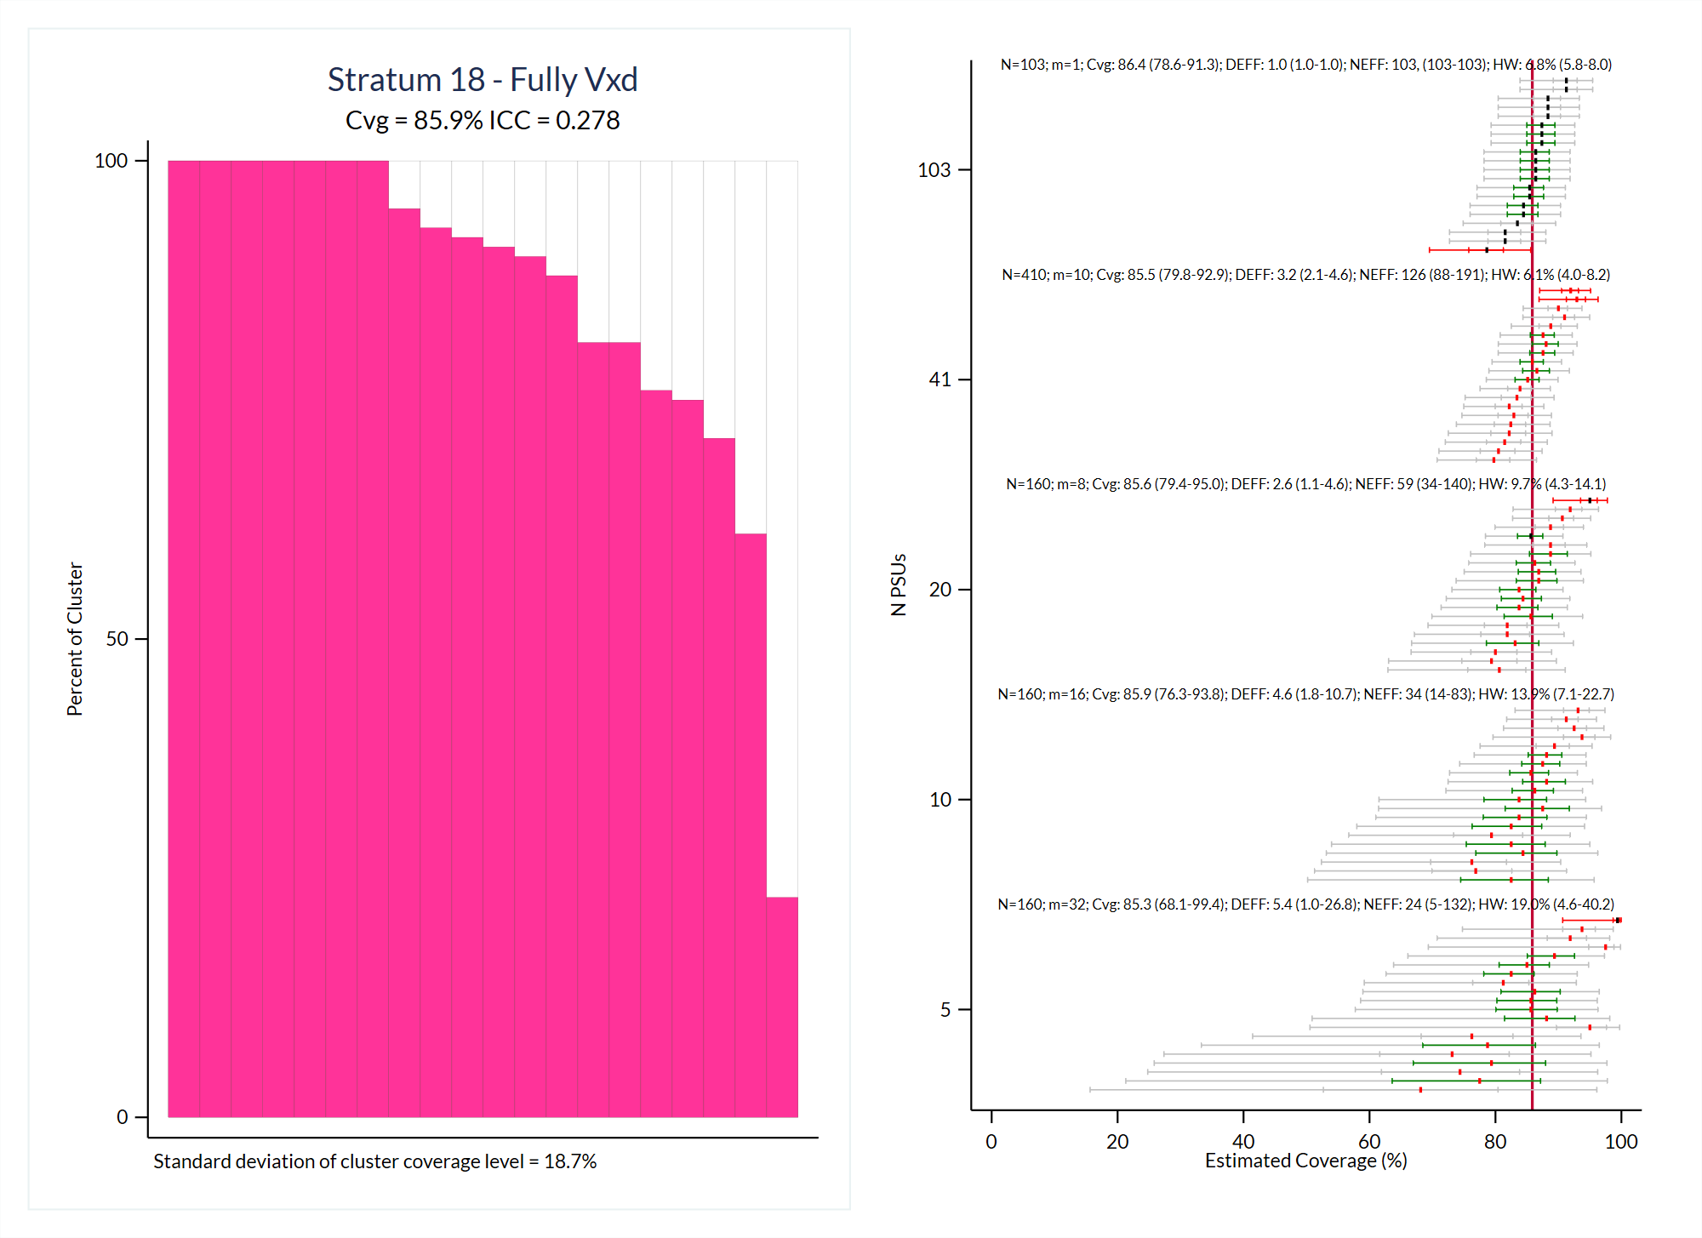

Slide 24
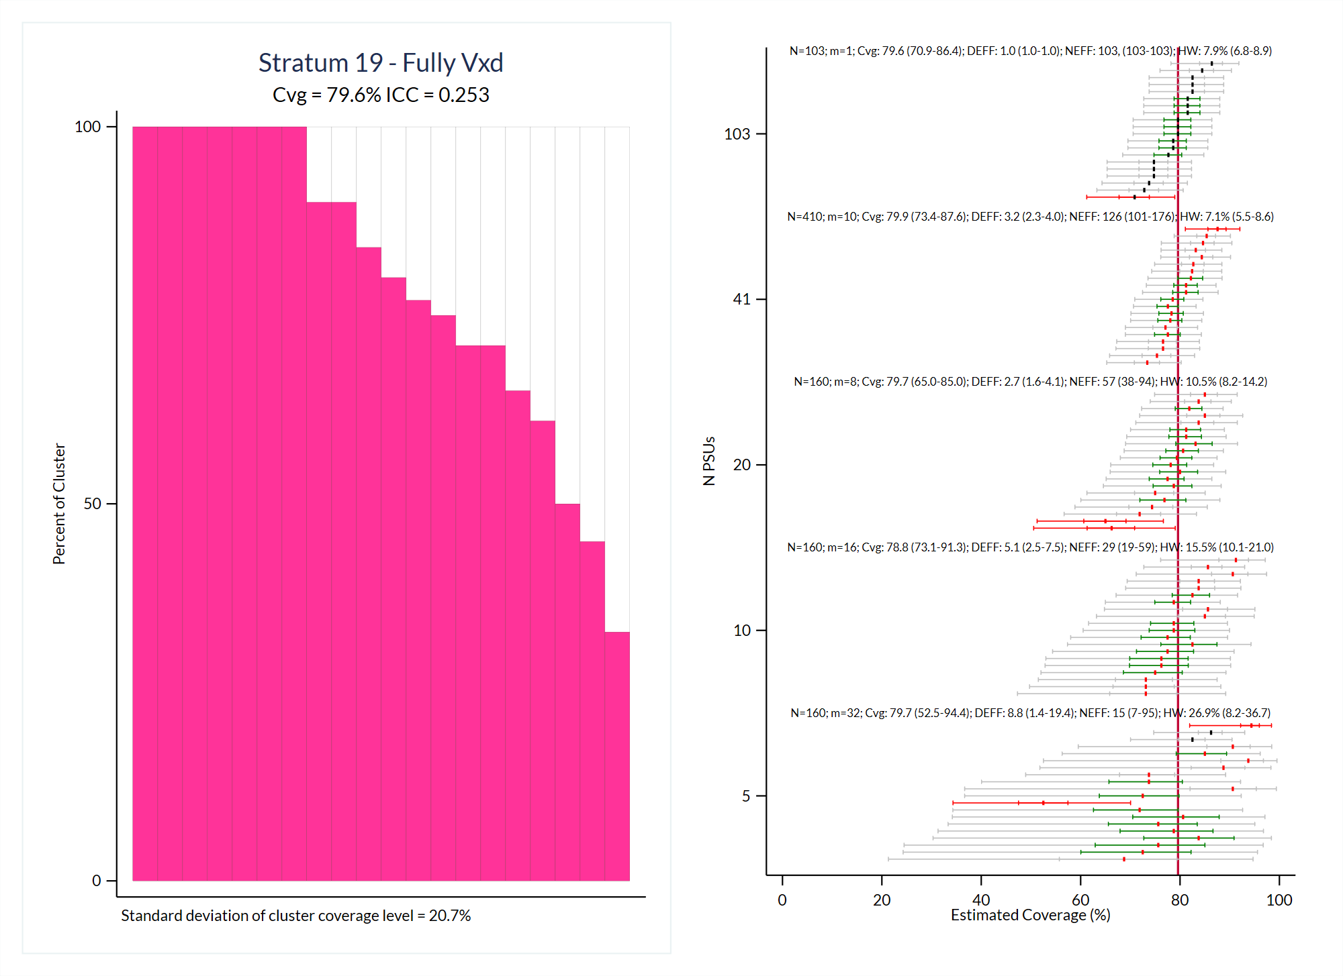

Slide 25
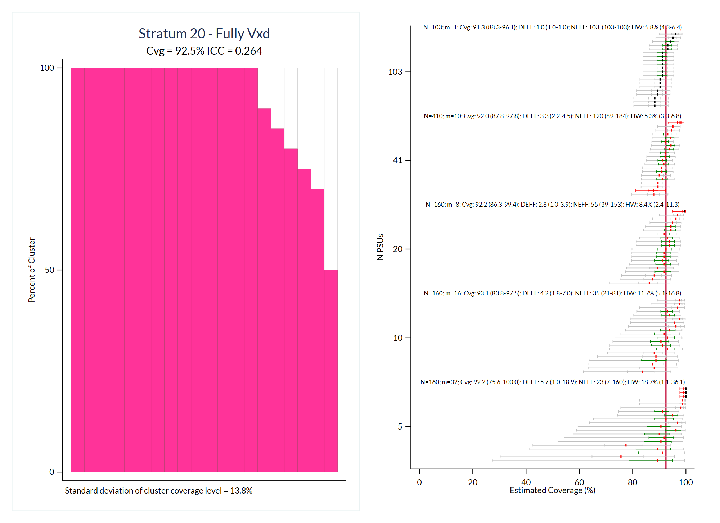

Slide 26
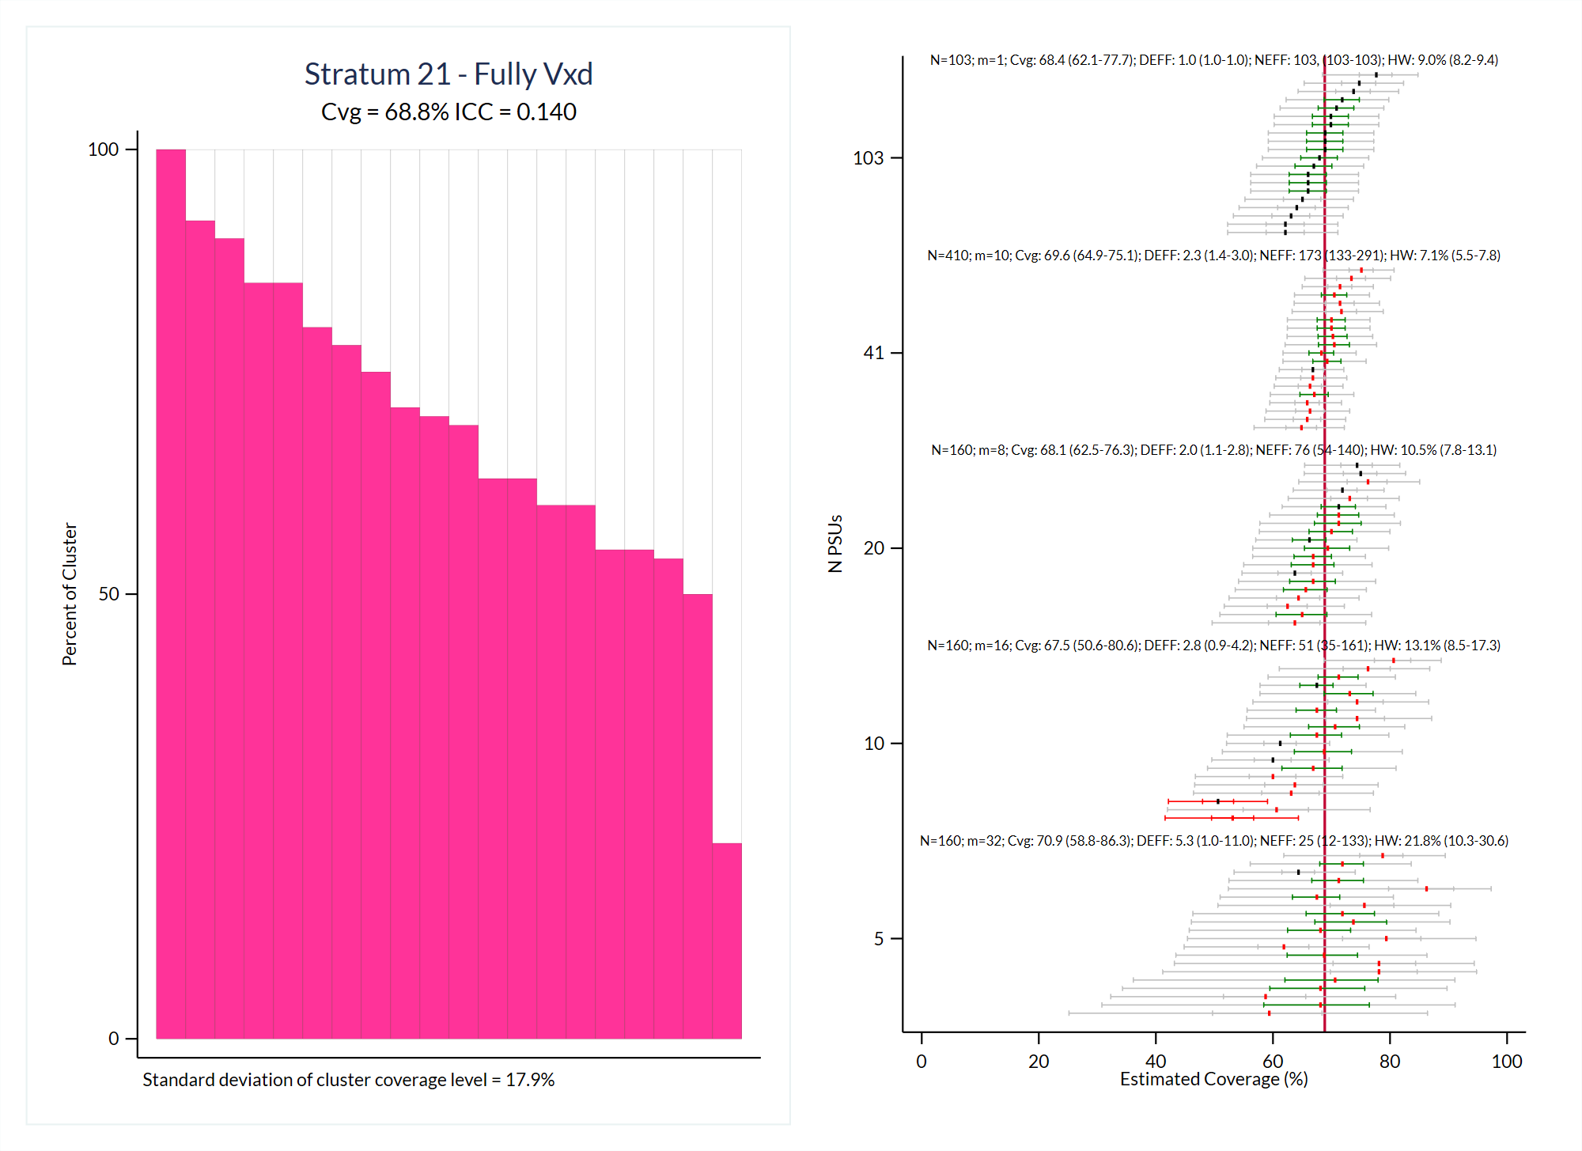

Slide 27
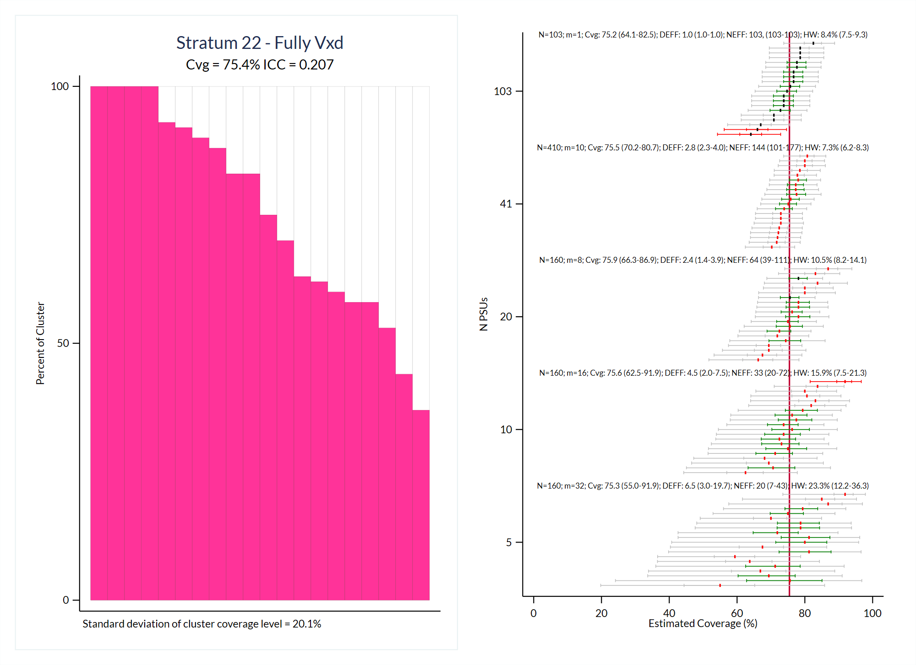

Slide 28
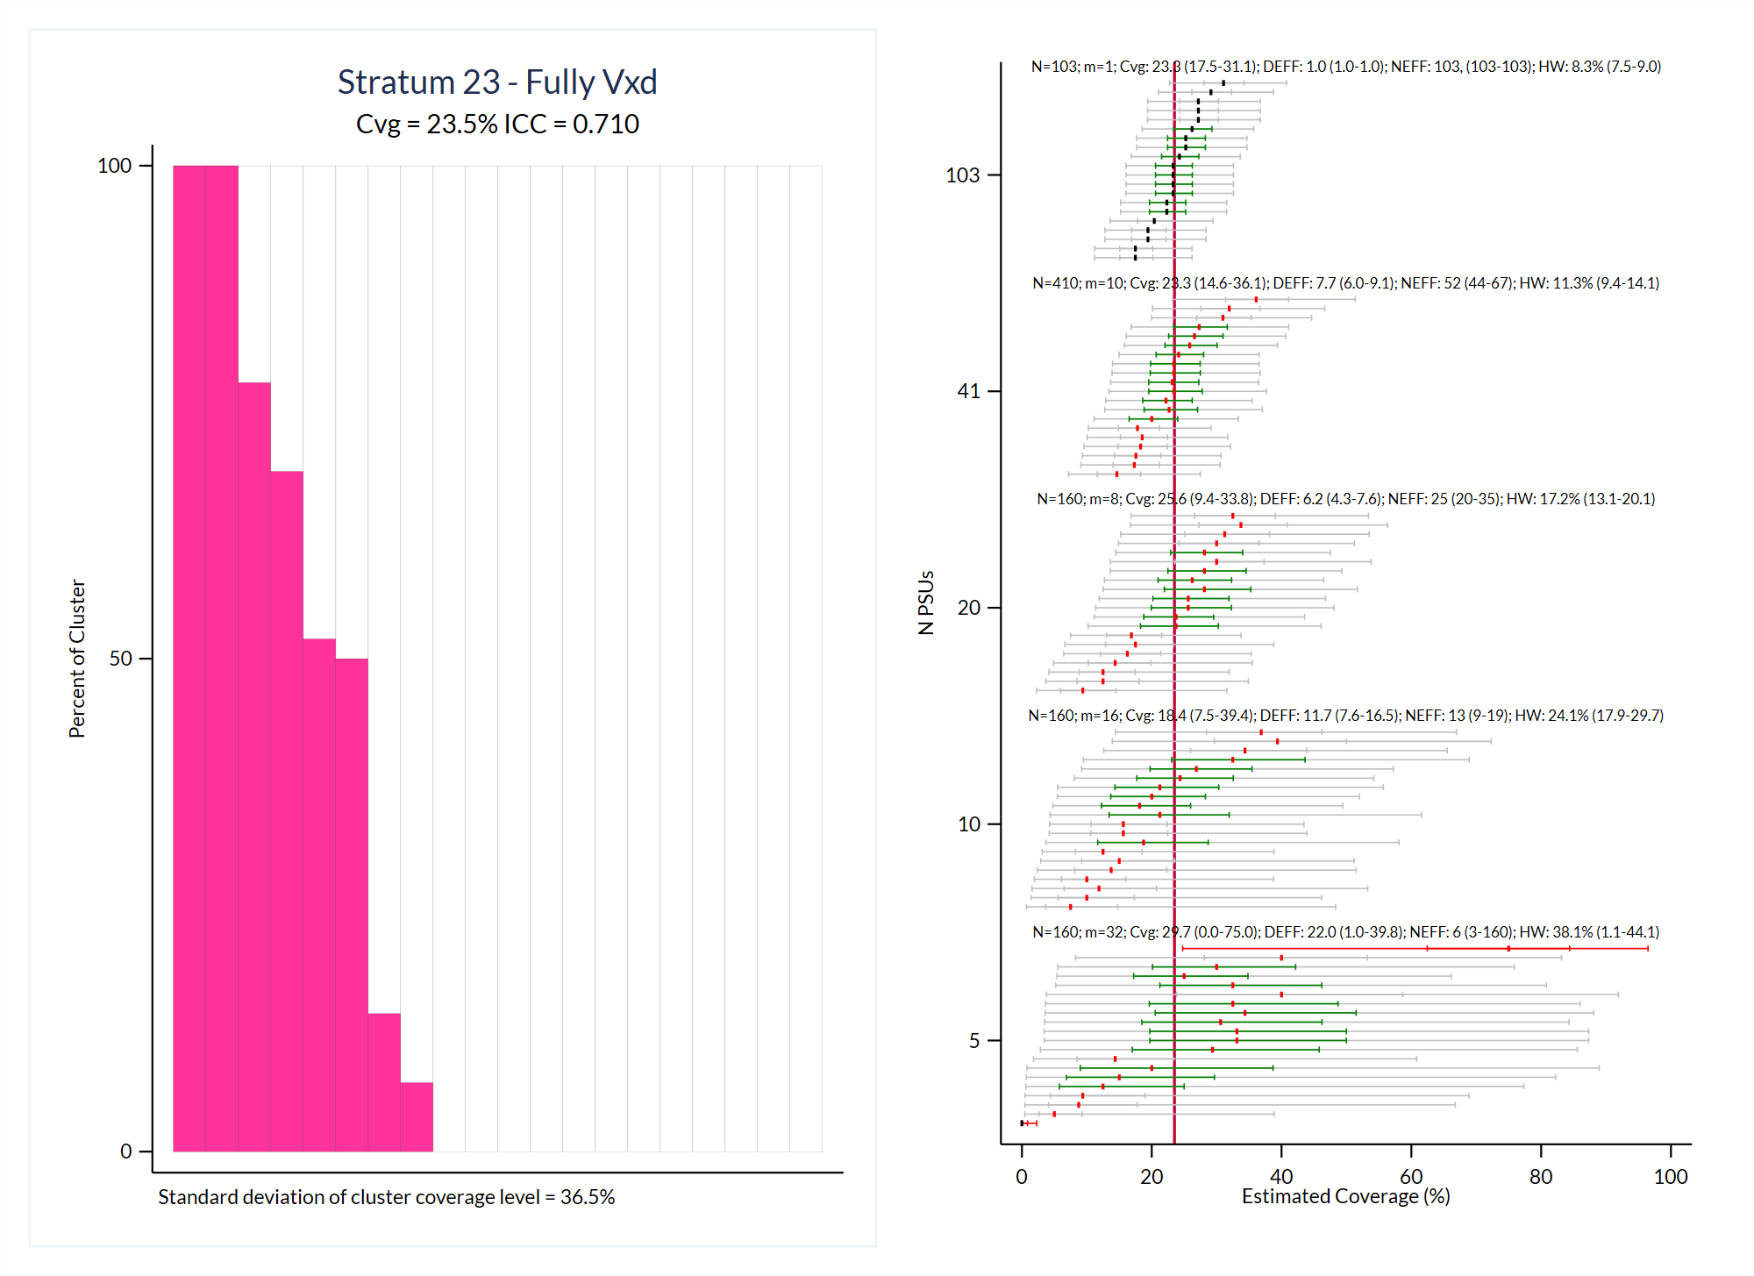

Slide 29
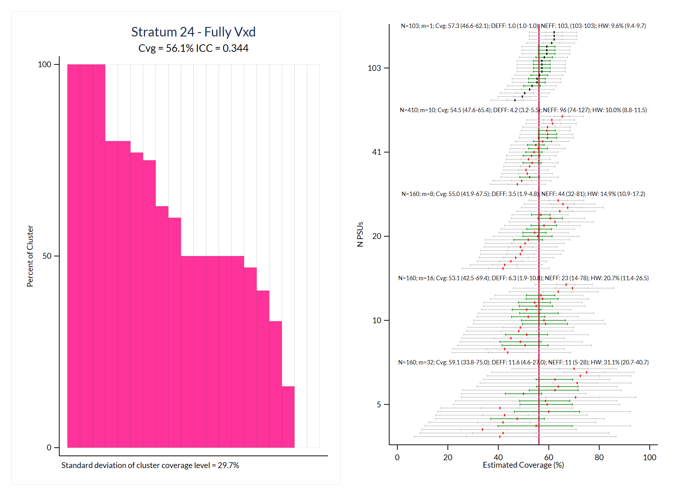

Slide 30
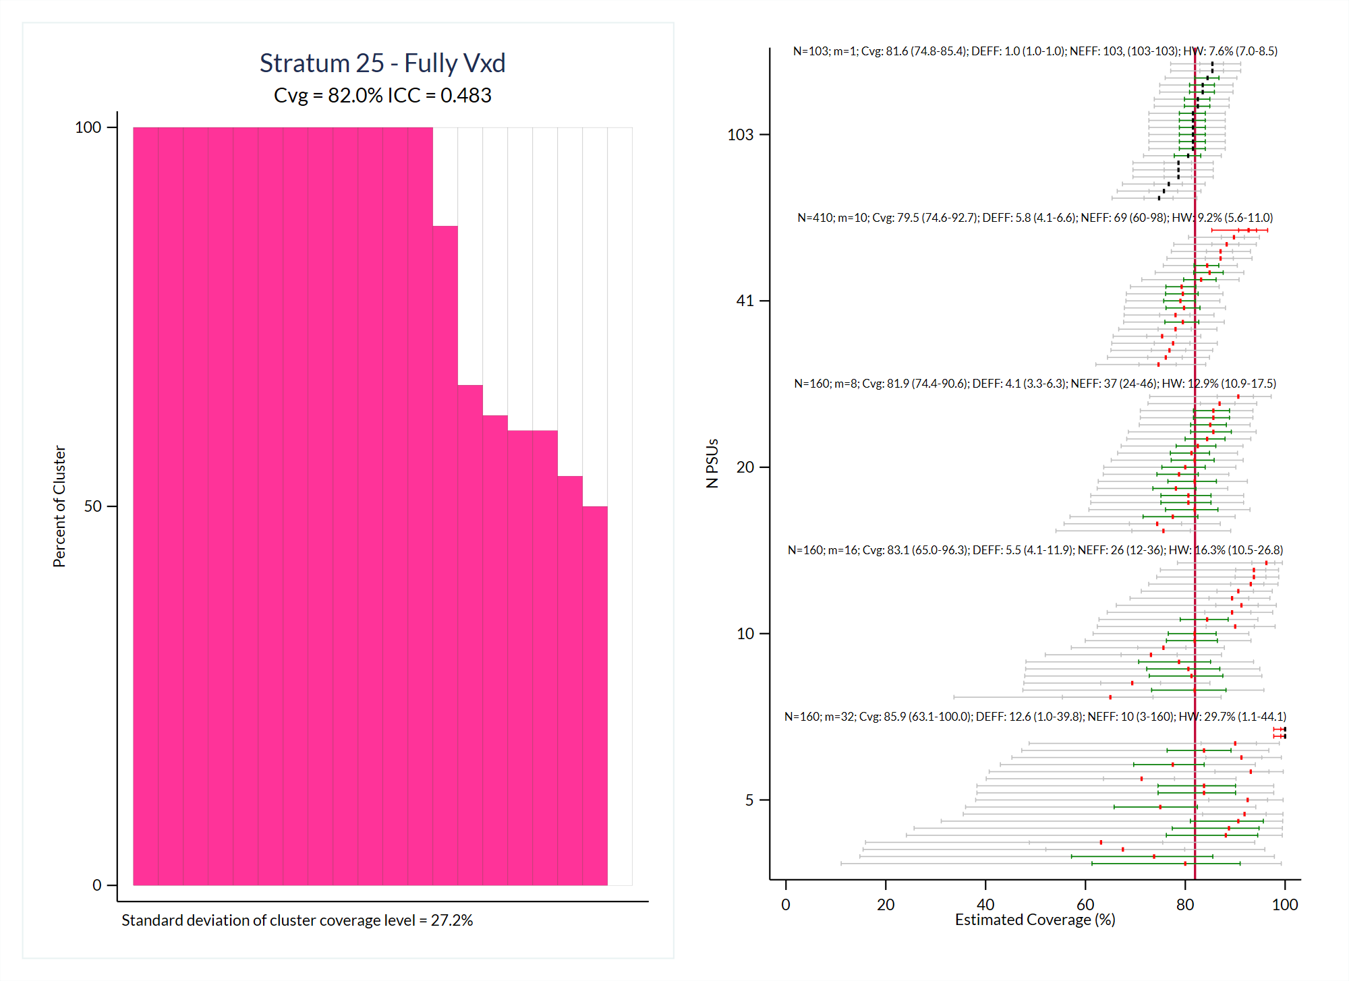

Slide 31
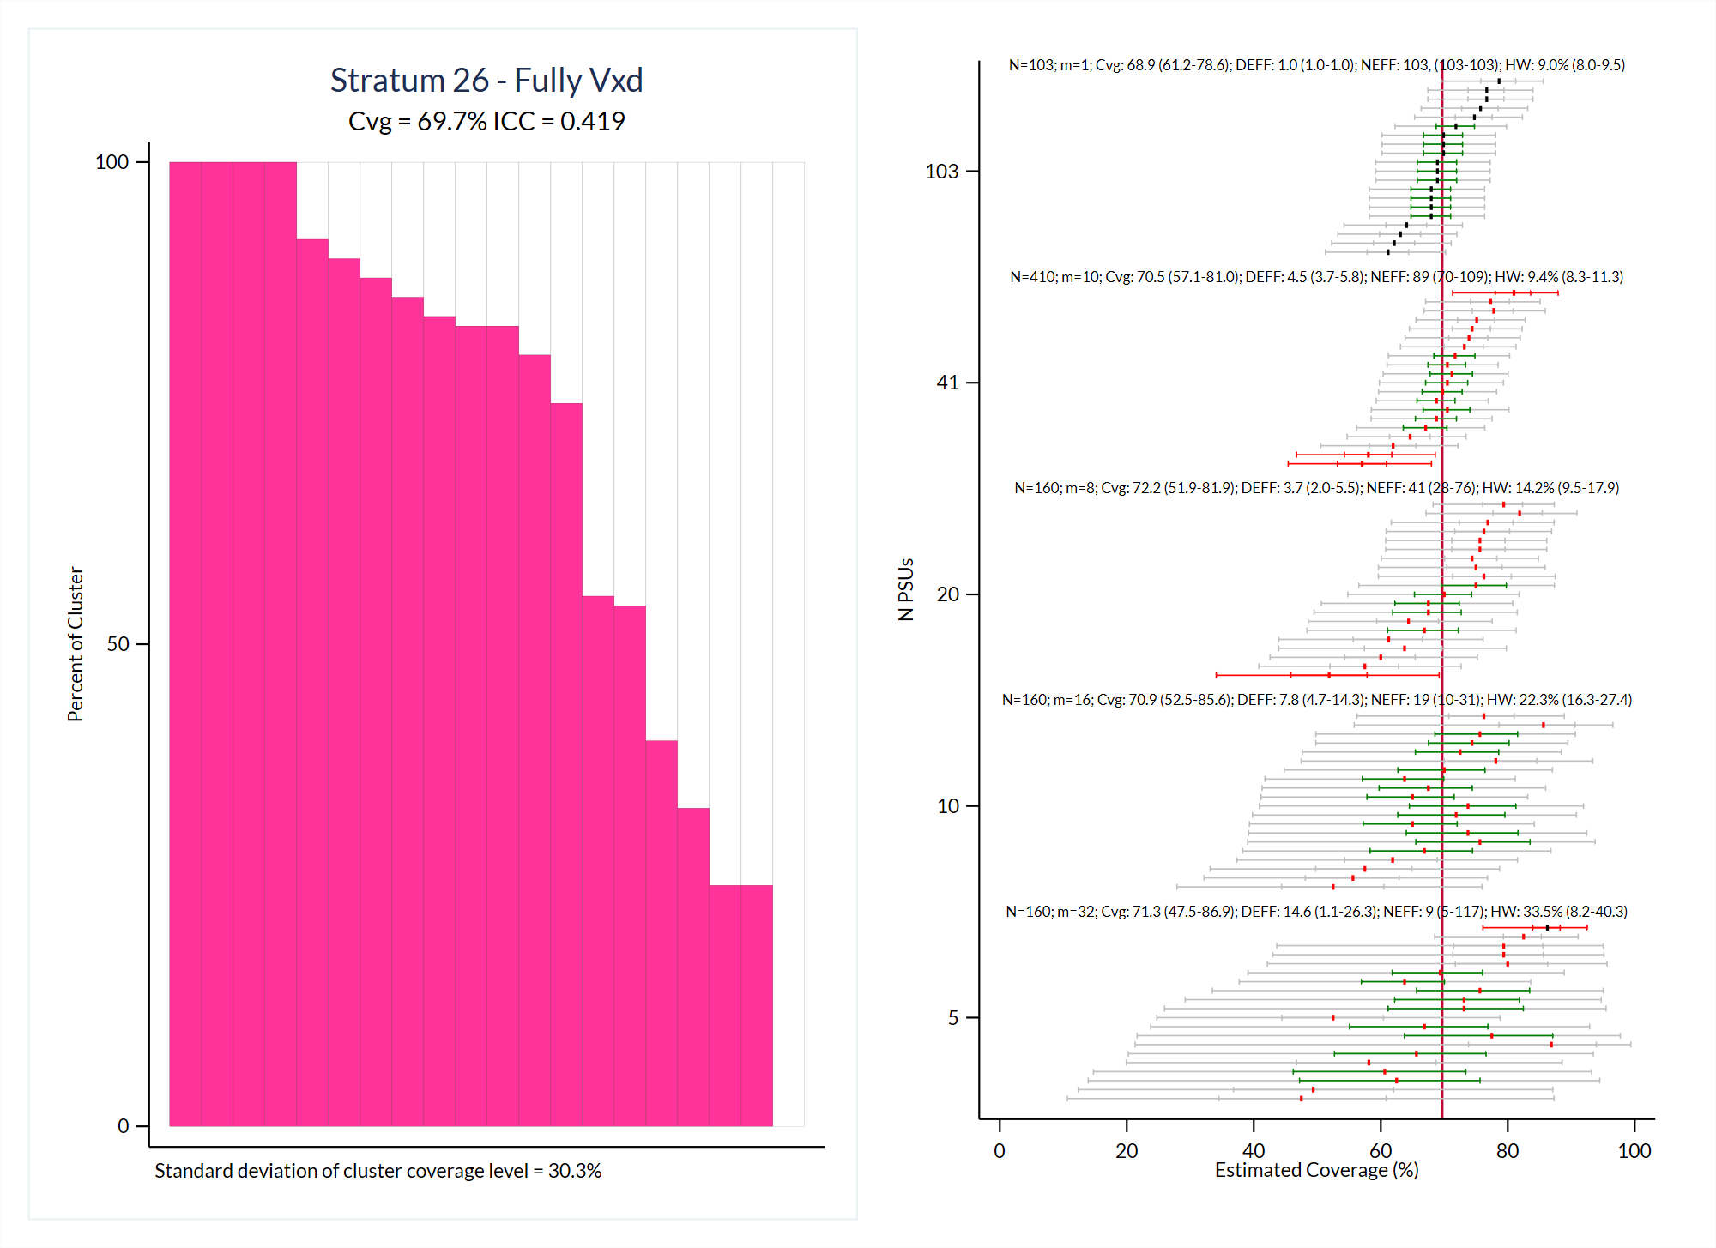

Slide 32
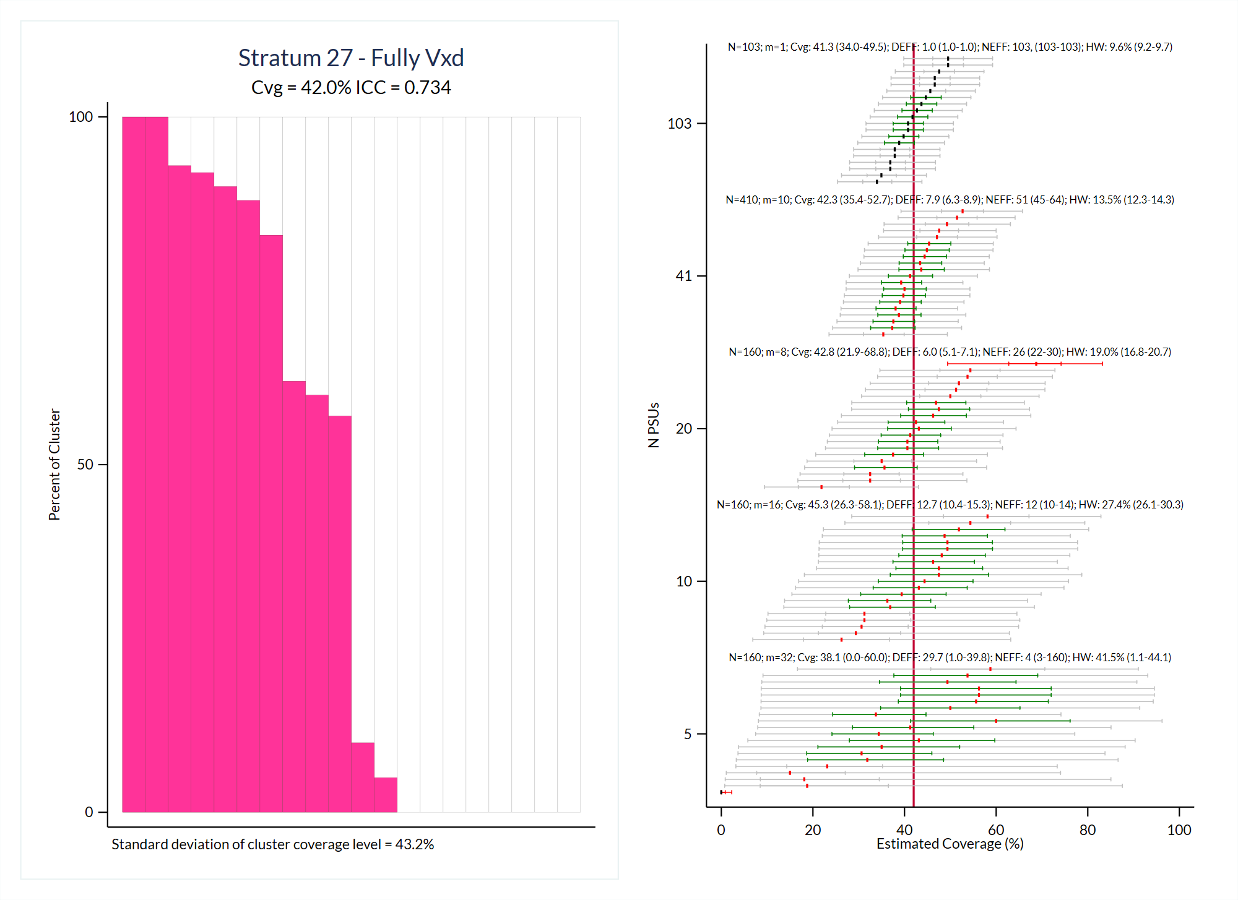

Slide 33
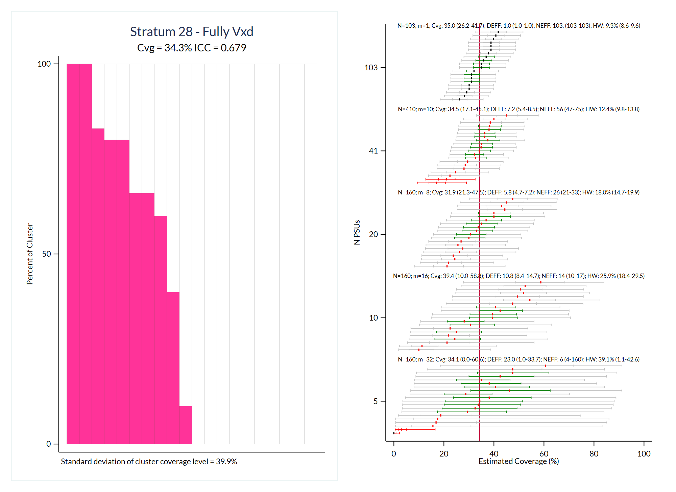

Slide 34
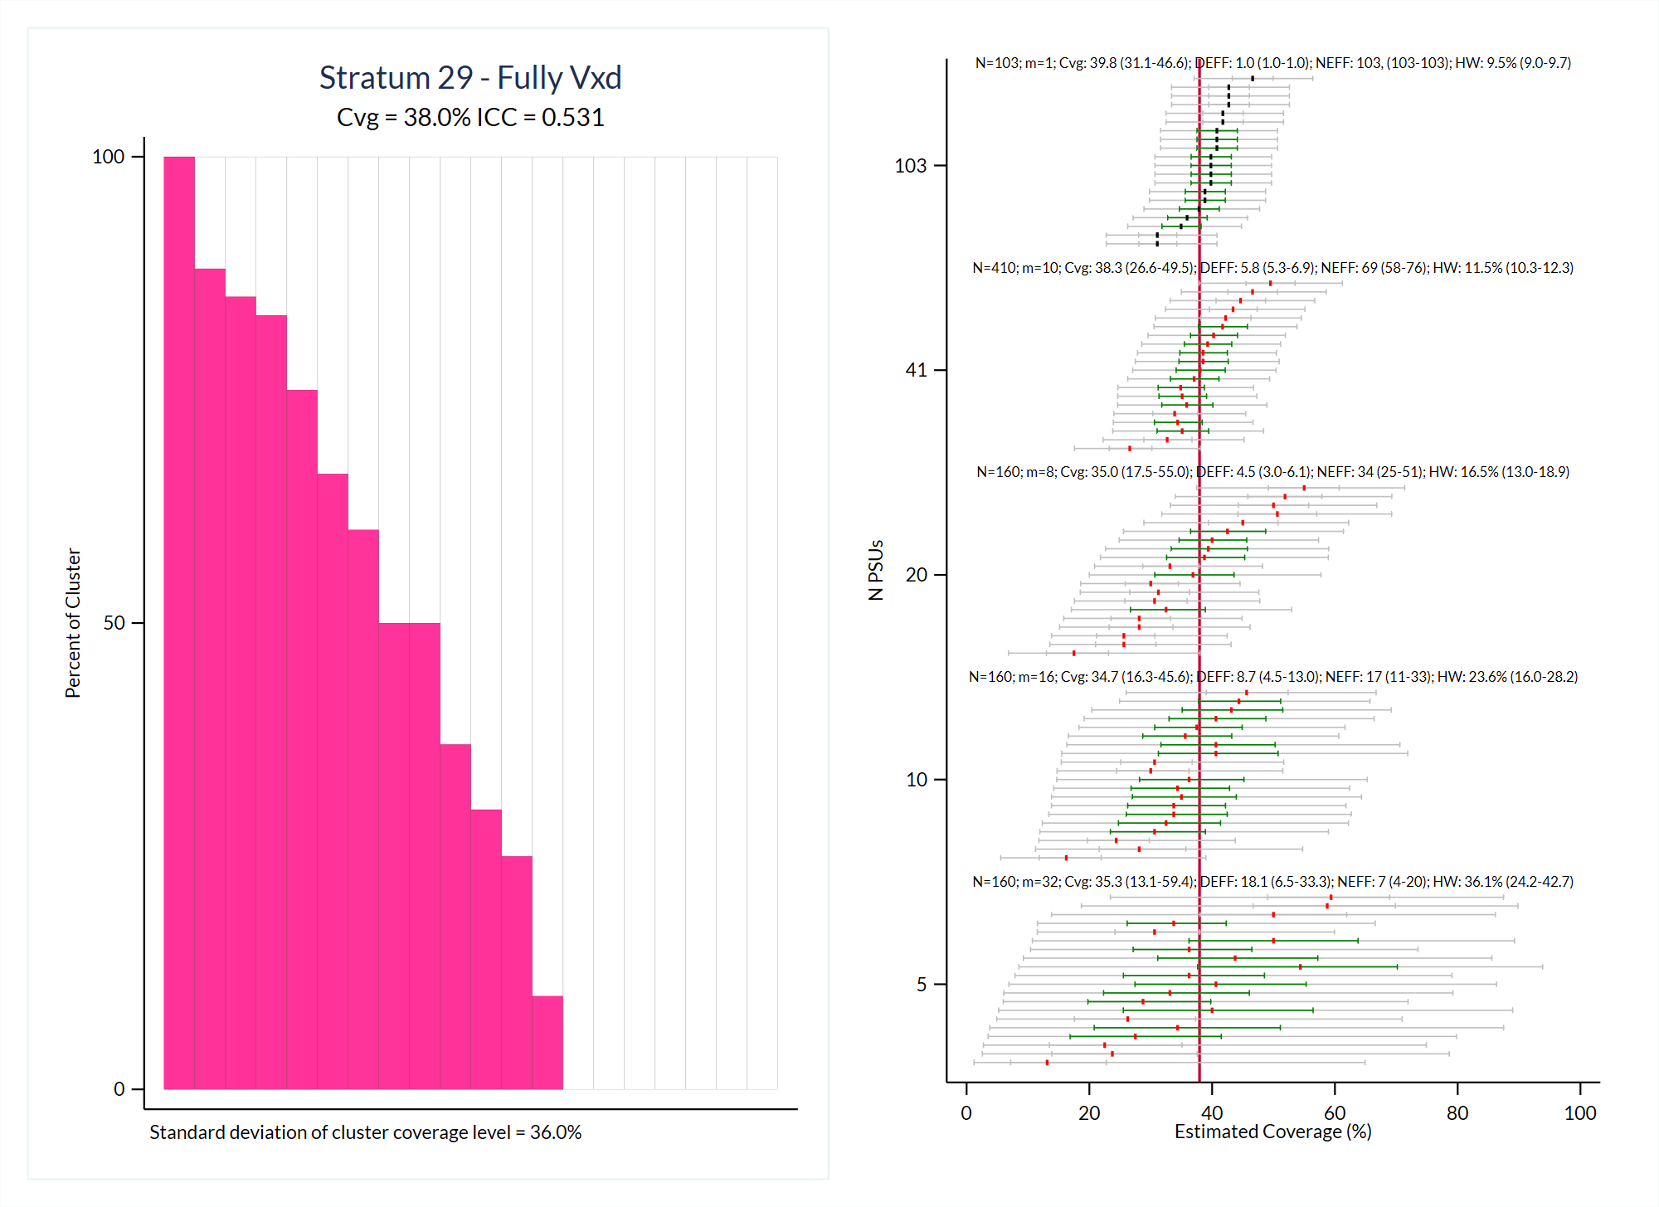

Slide 35
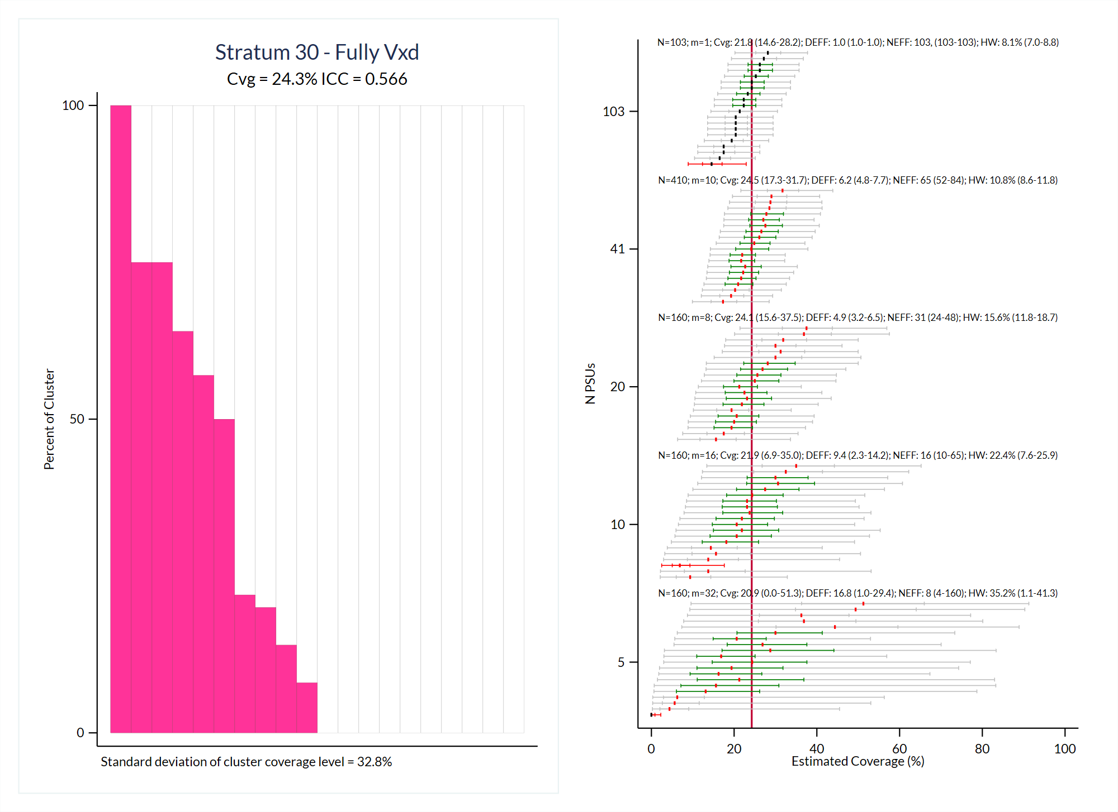

Slide 36
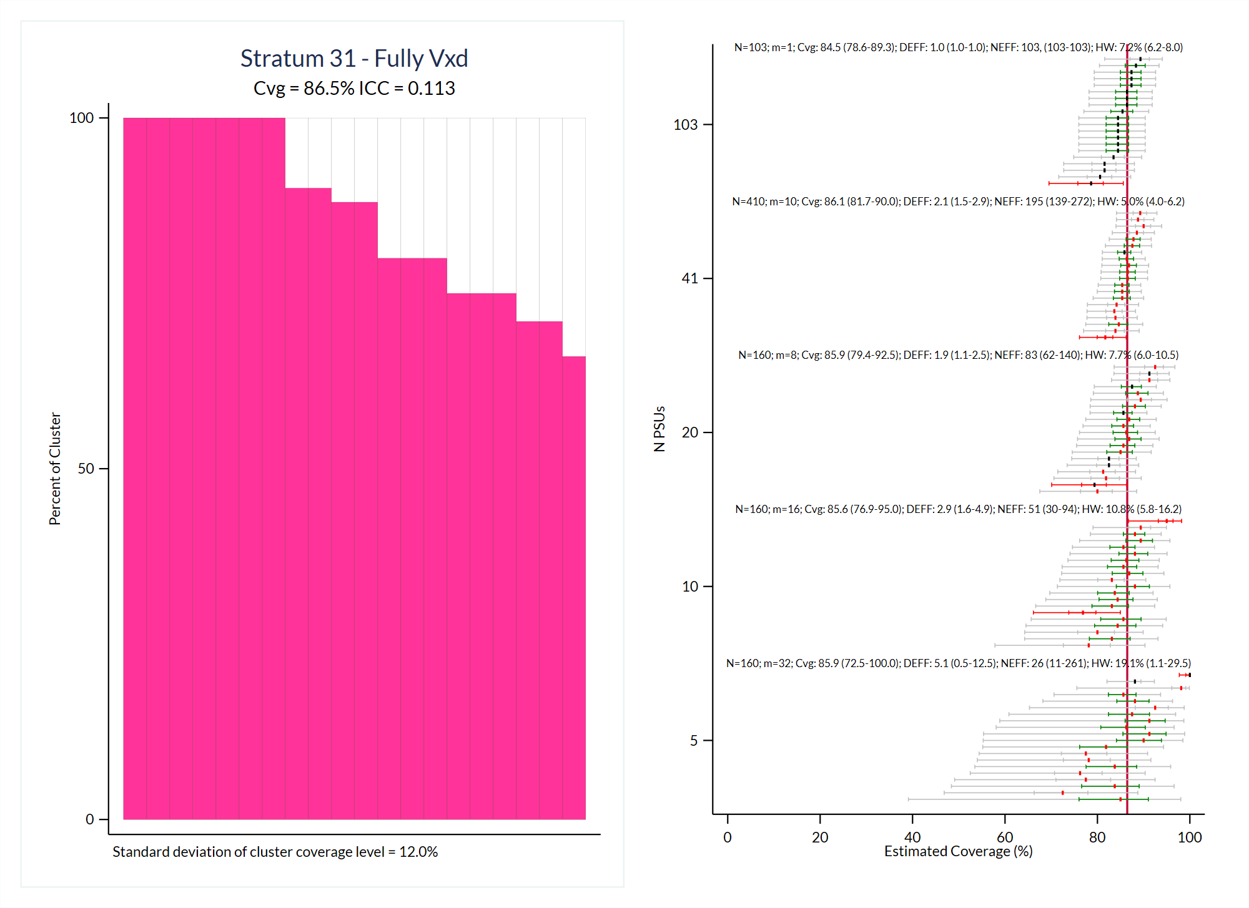

Slide 37
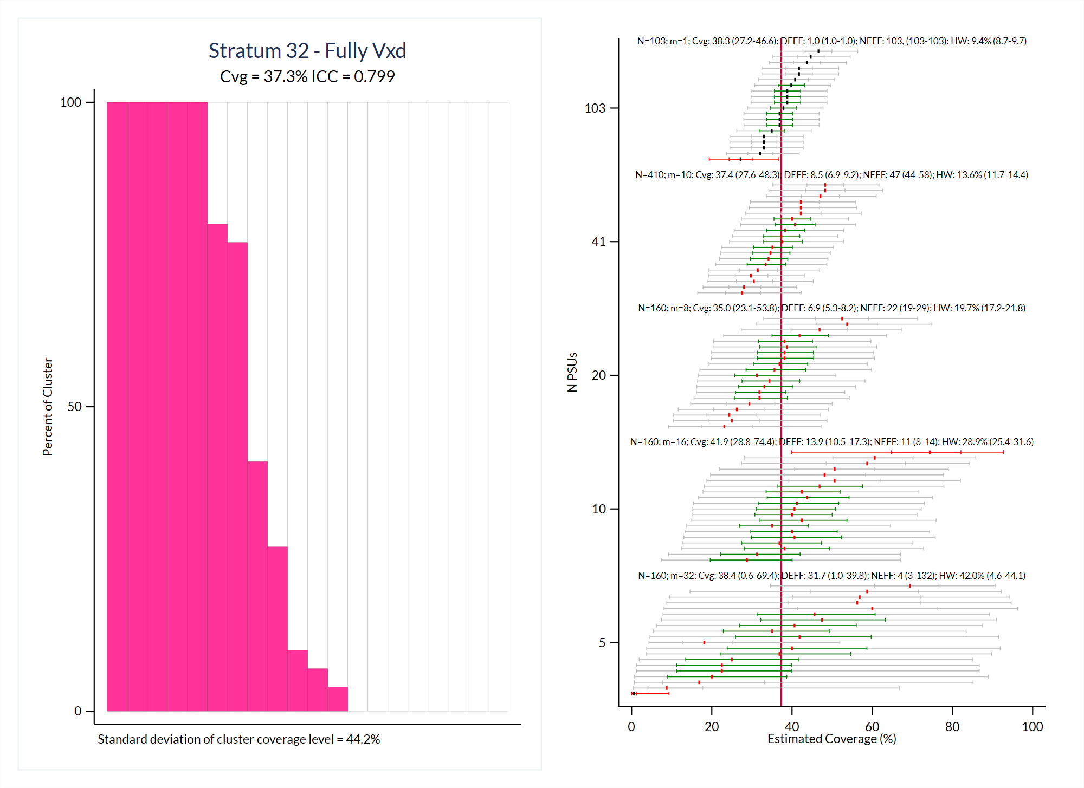

Slide 38
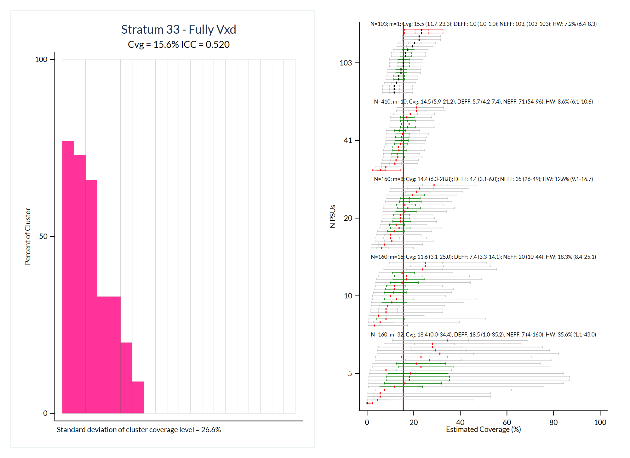

Slide 39
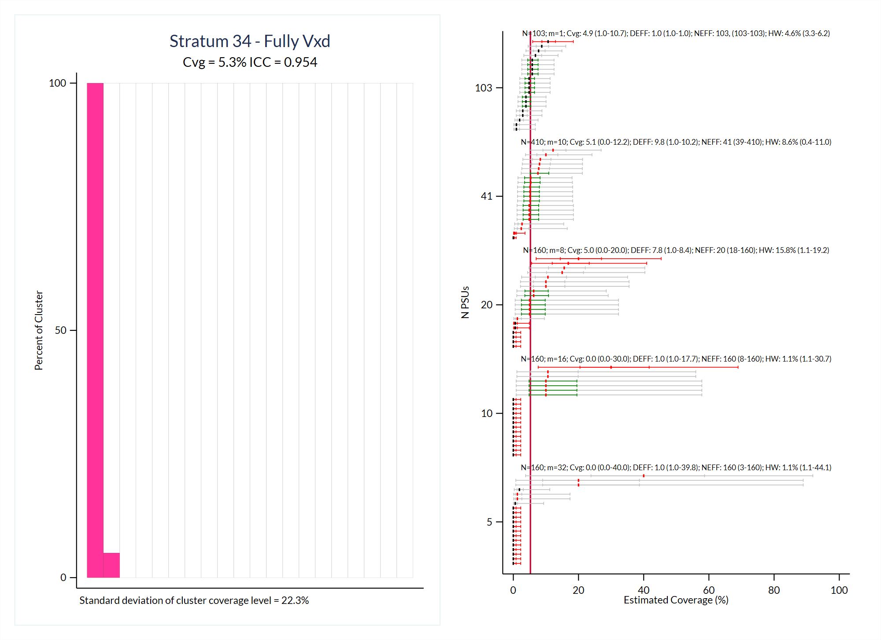

Slide 40
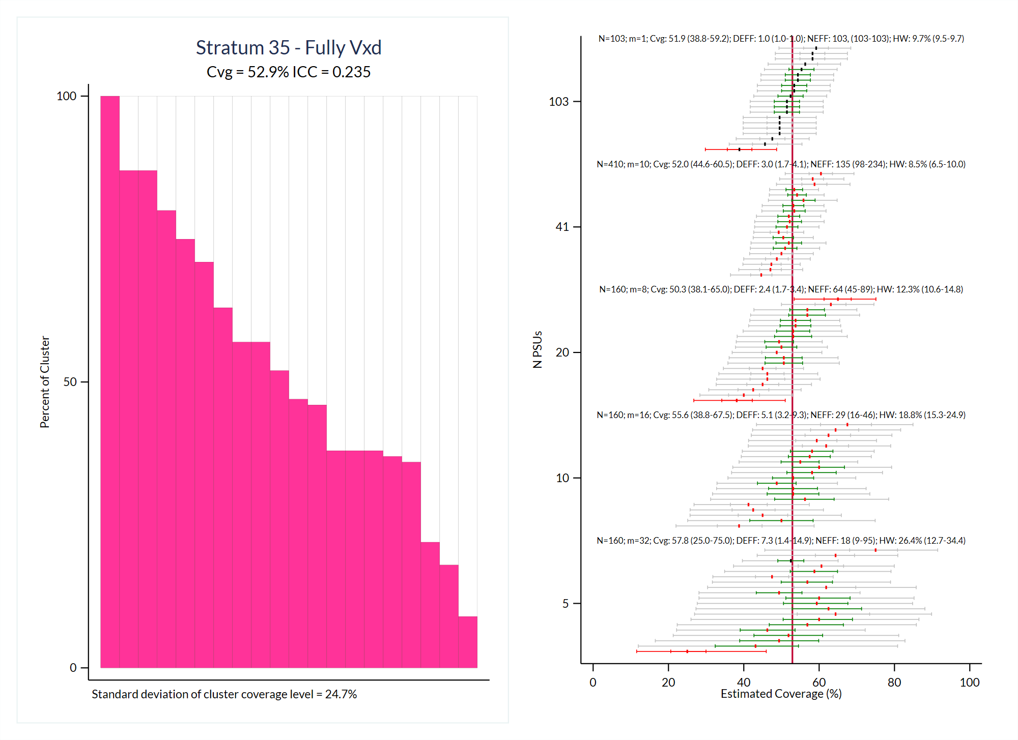

Slide 41
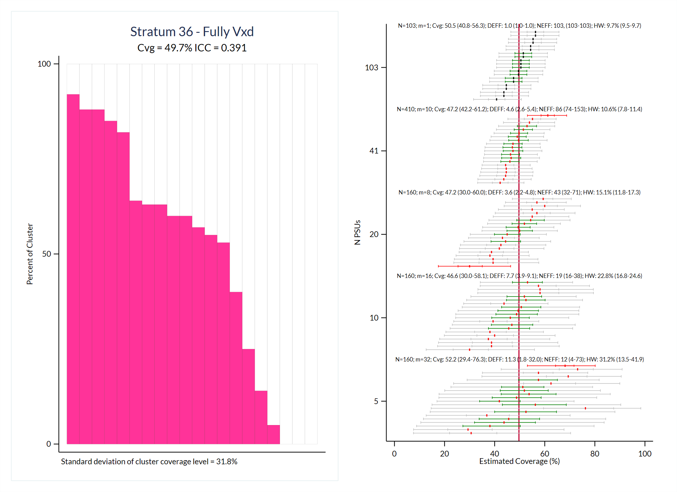

Slide 42
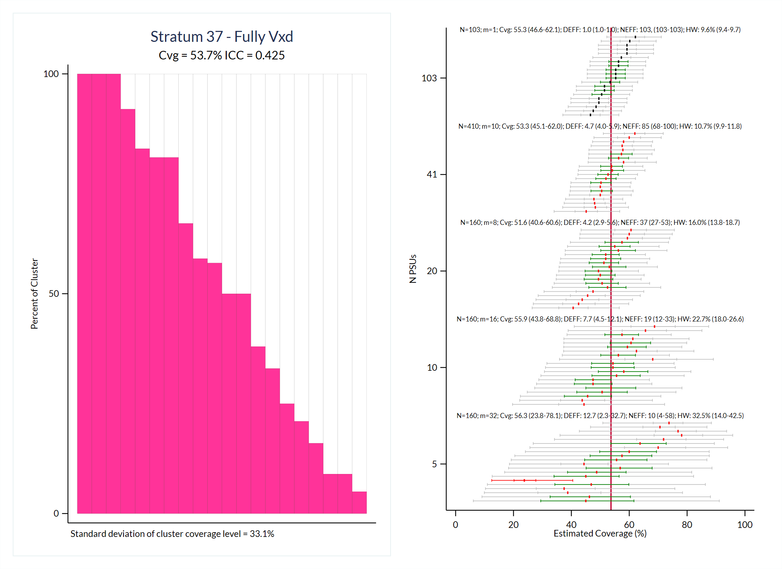

Slide 43
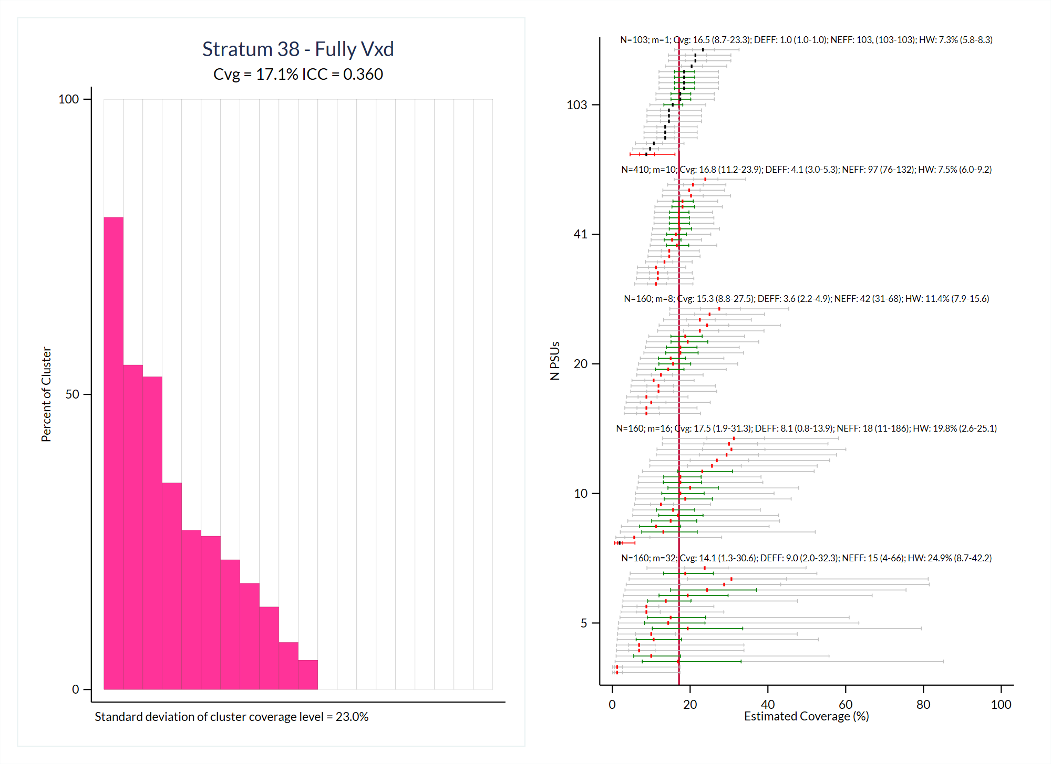

Slide 44
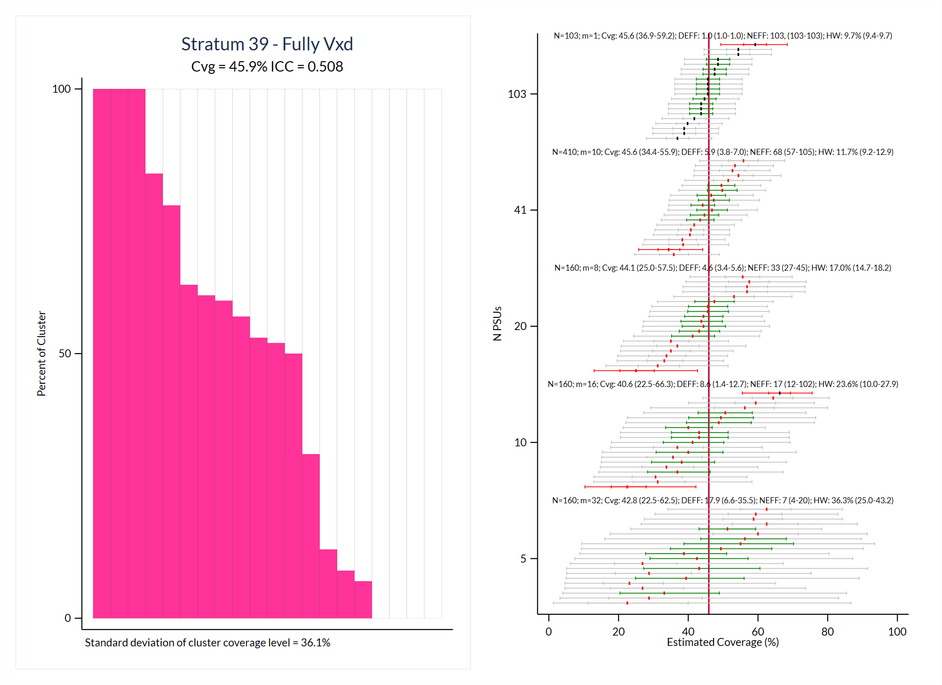

Slide 45
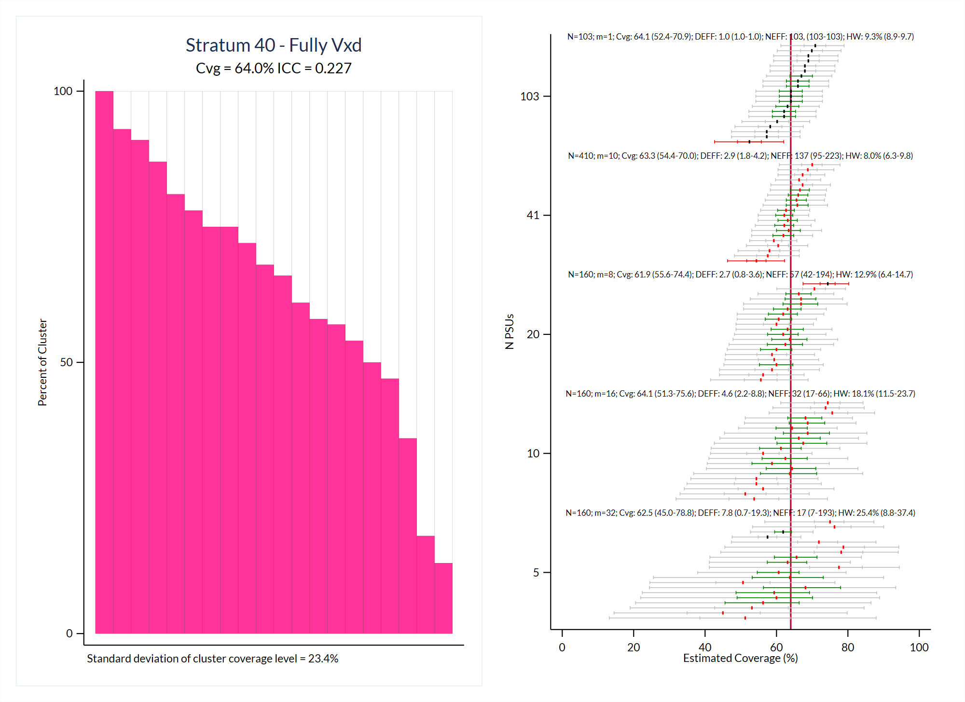

Slide 46
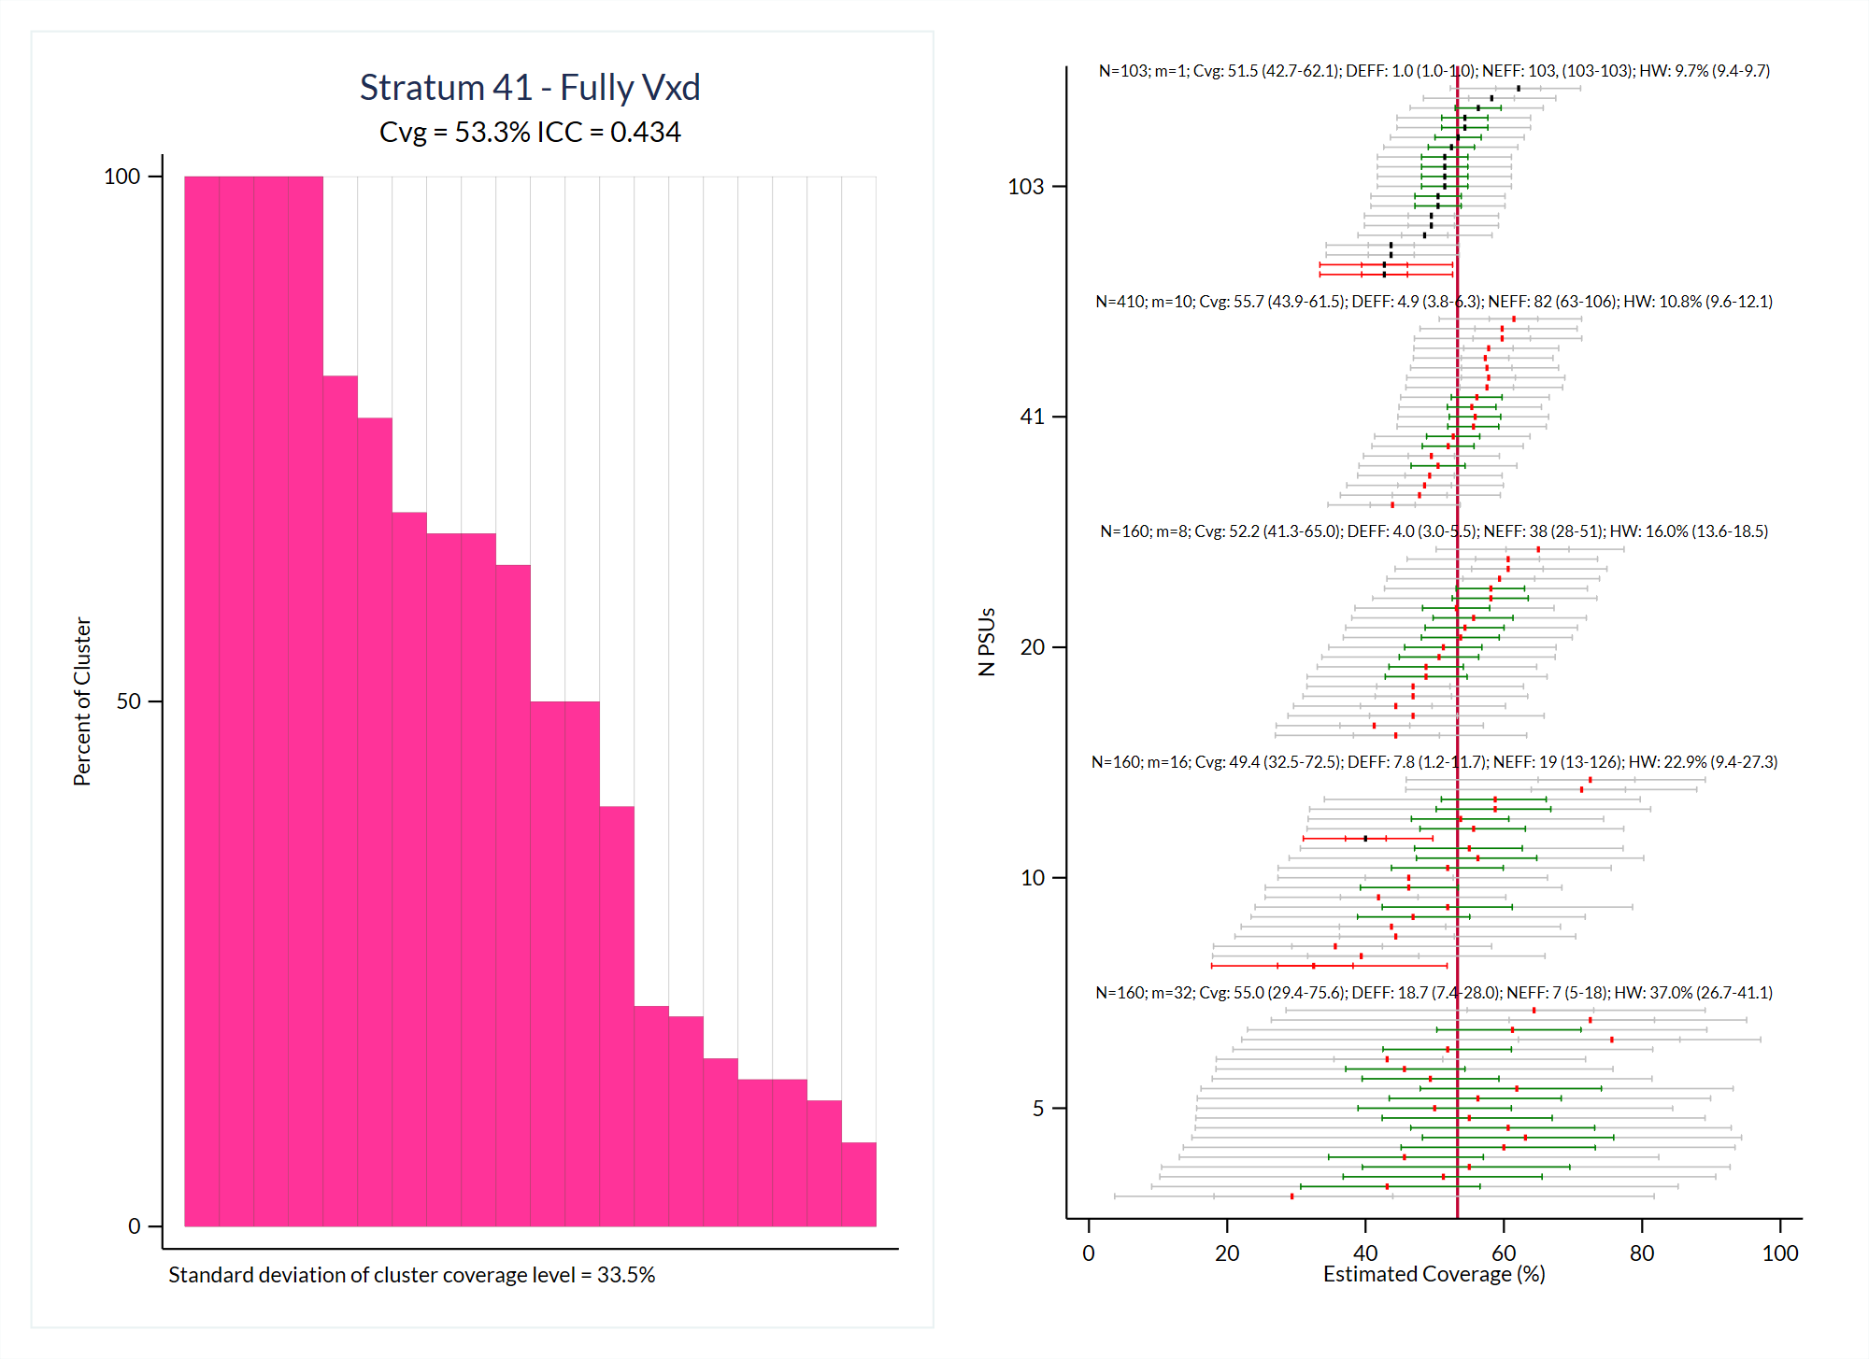

Slide 47
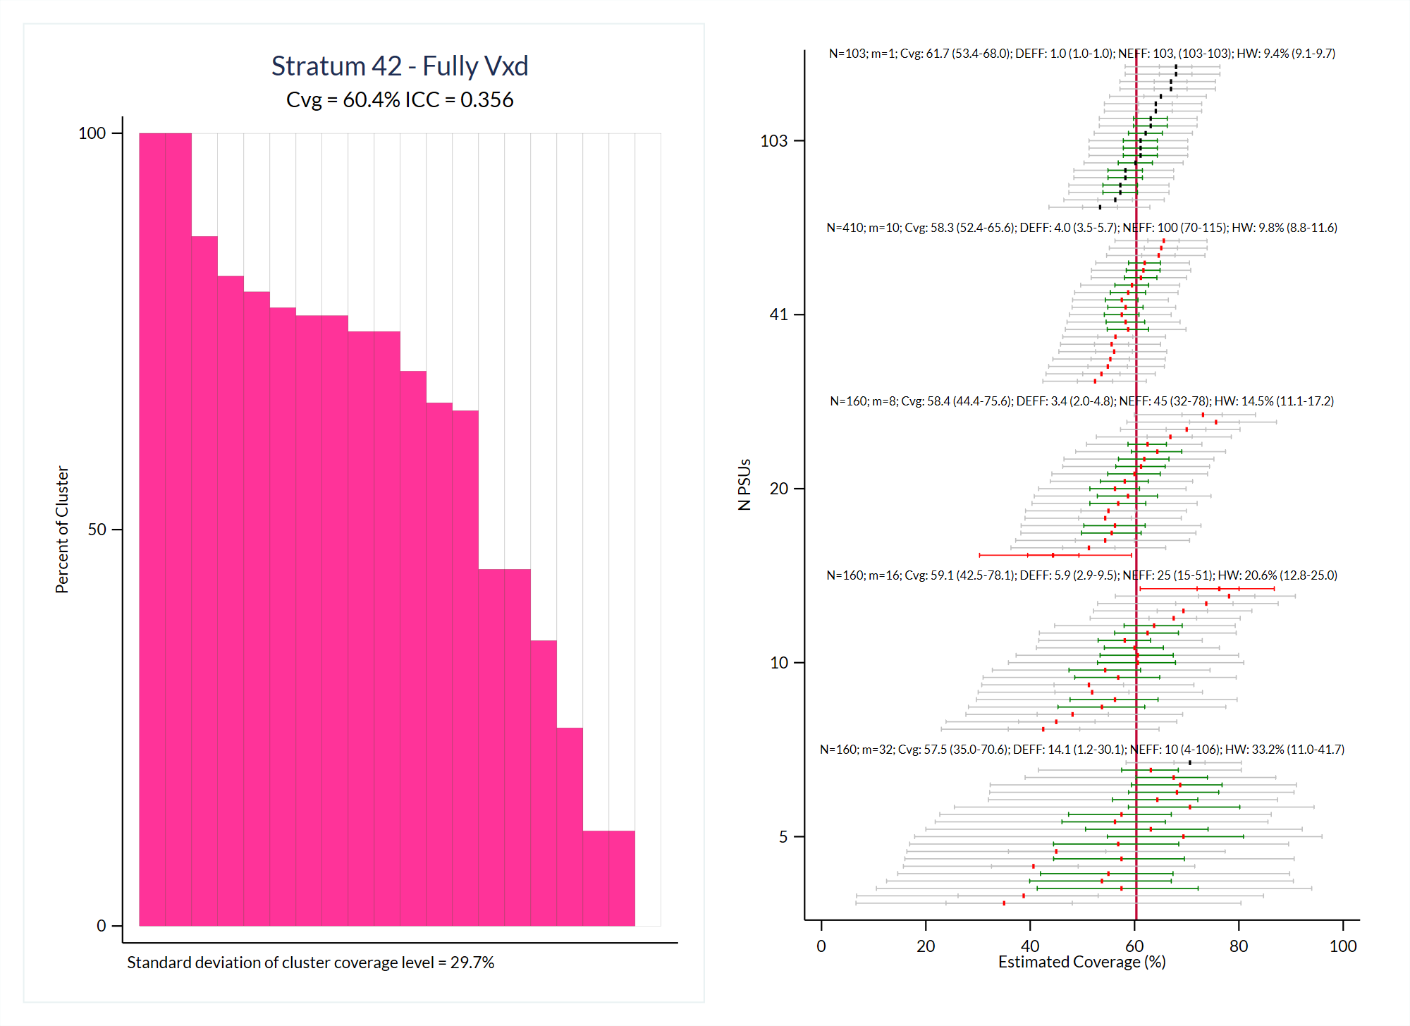

Slide 48
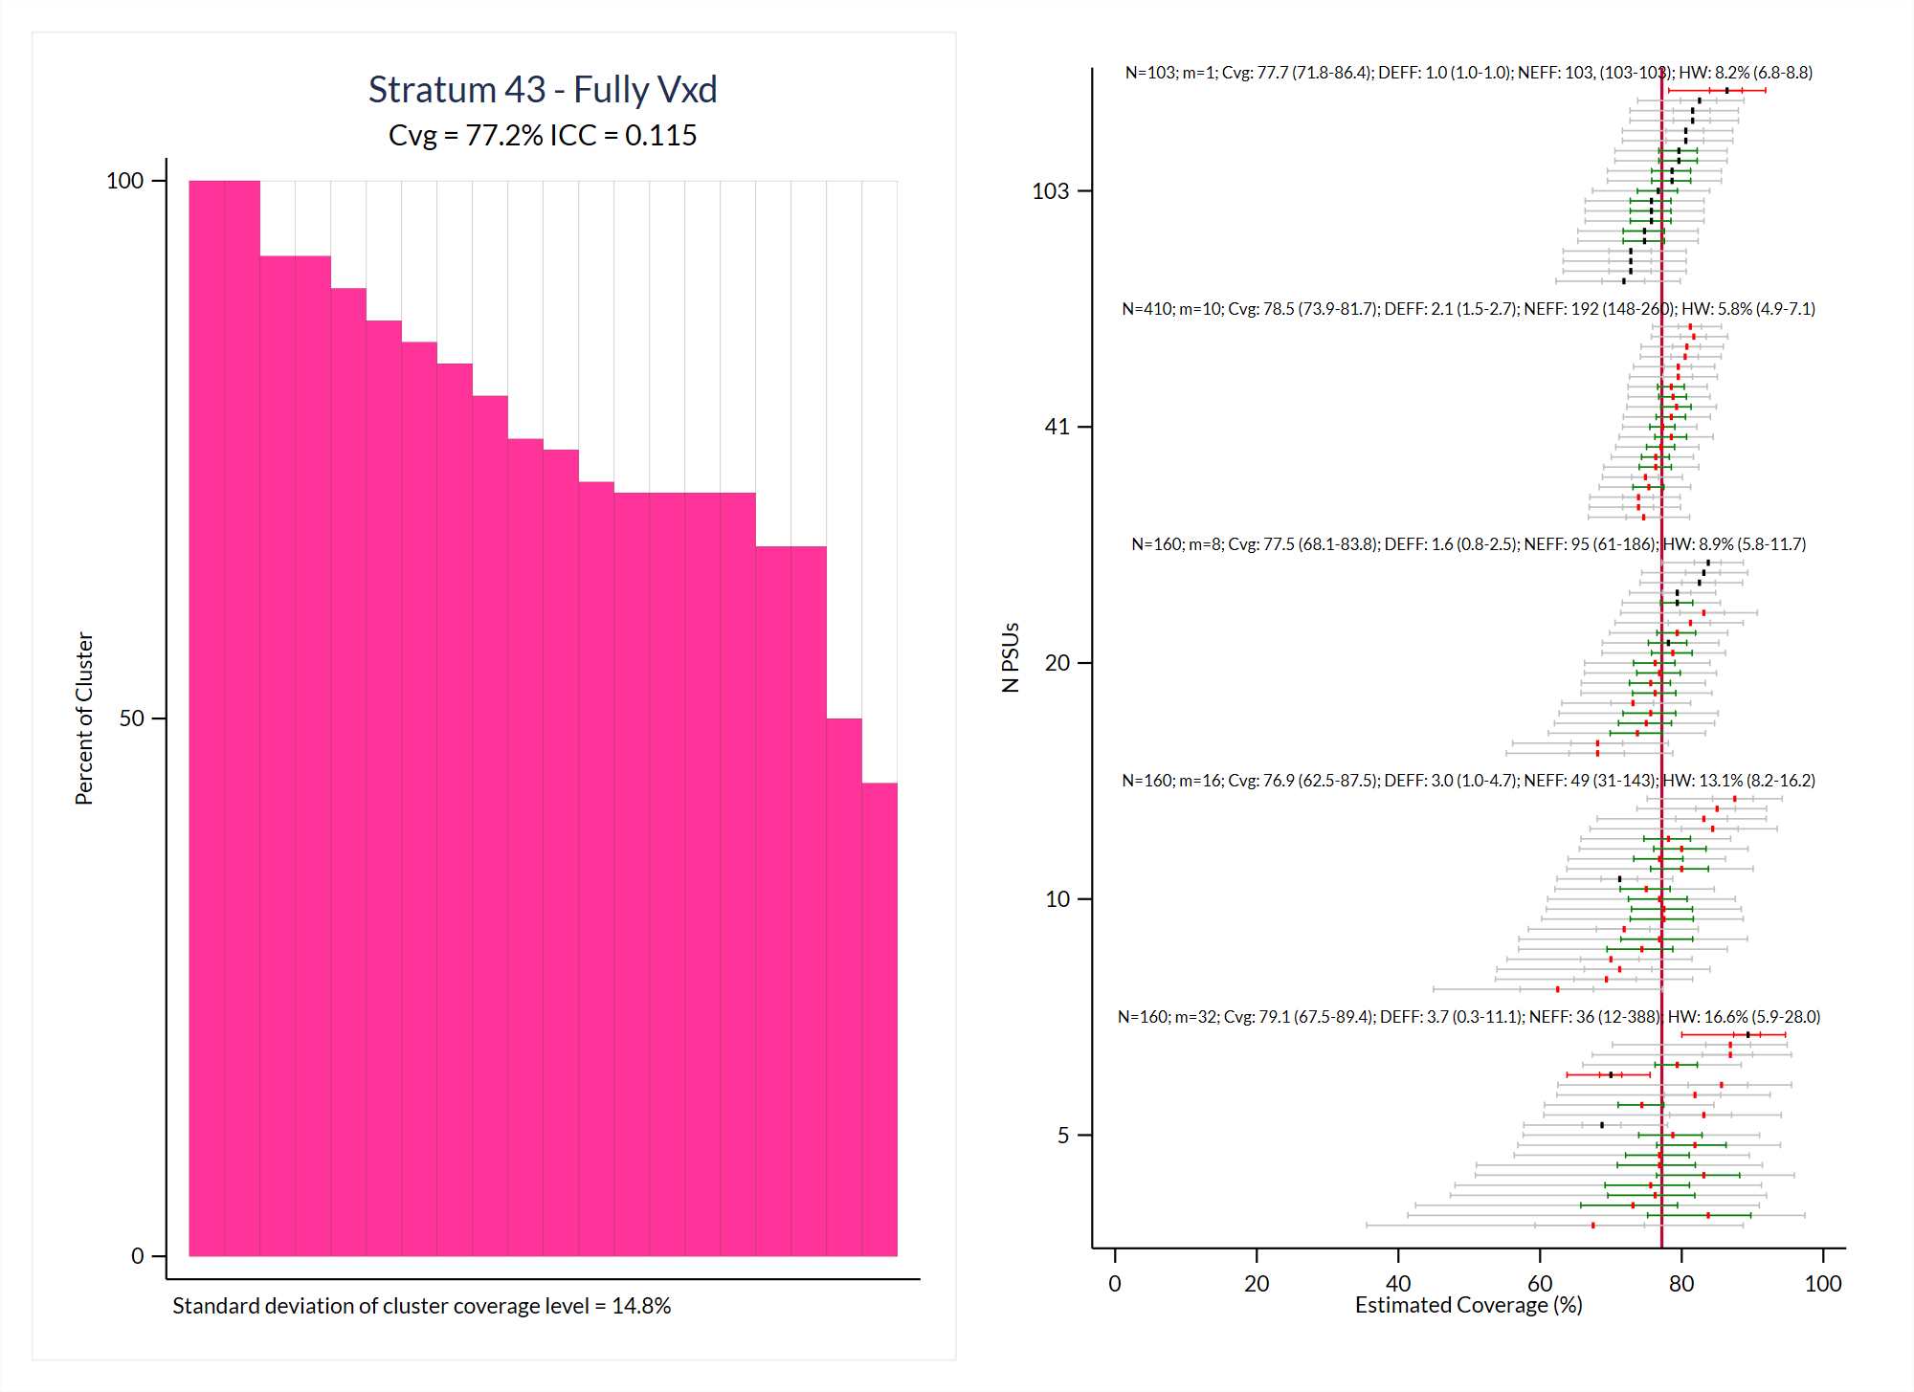

Slide 49
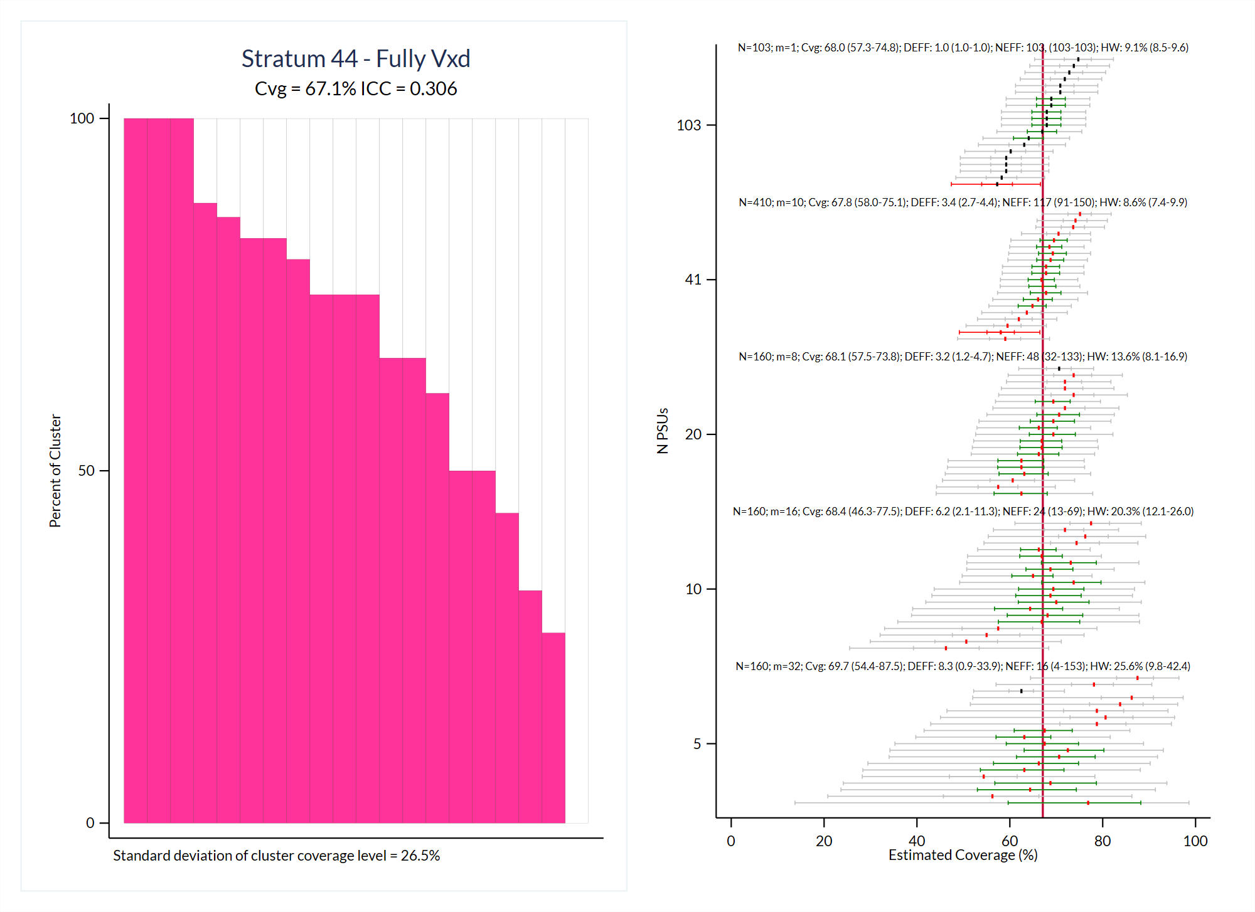

Slide 50
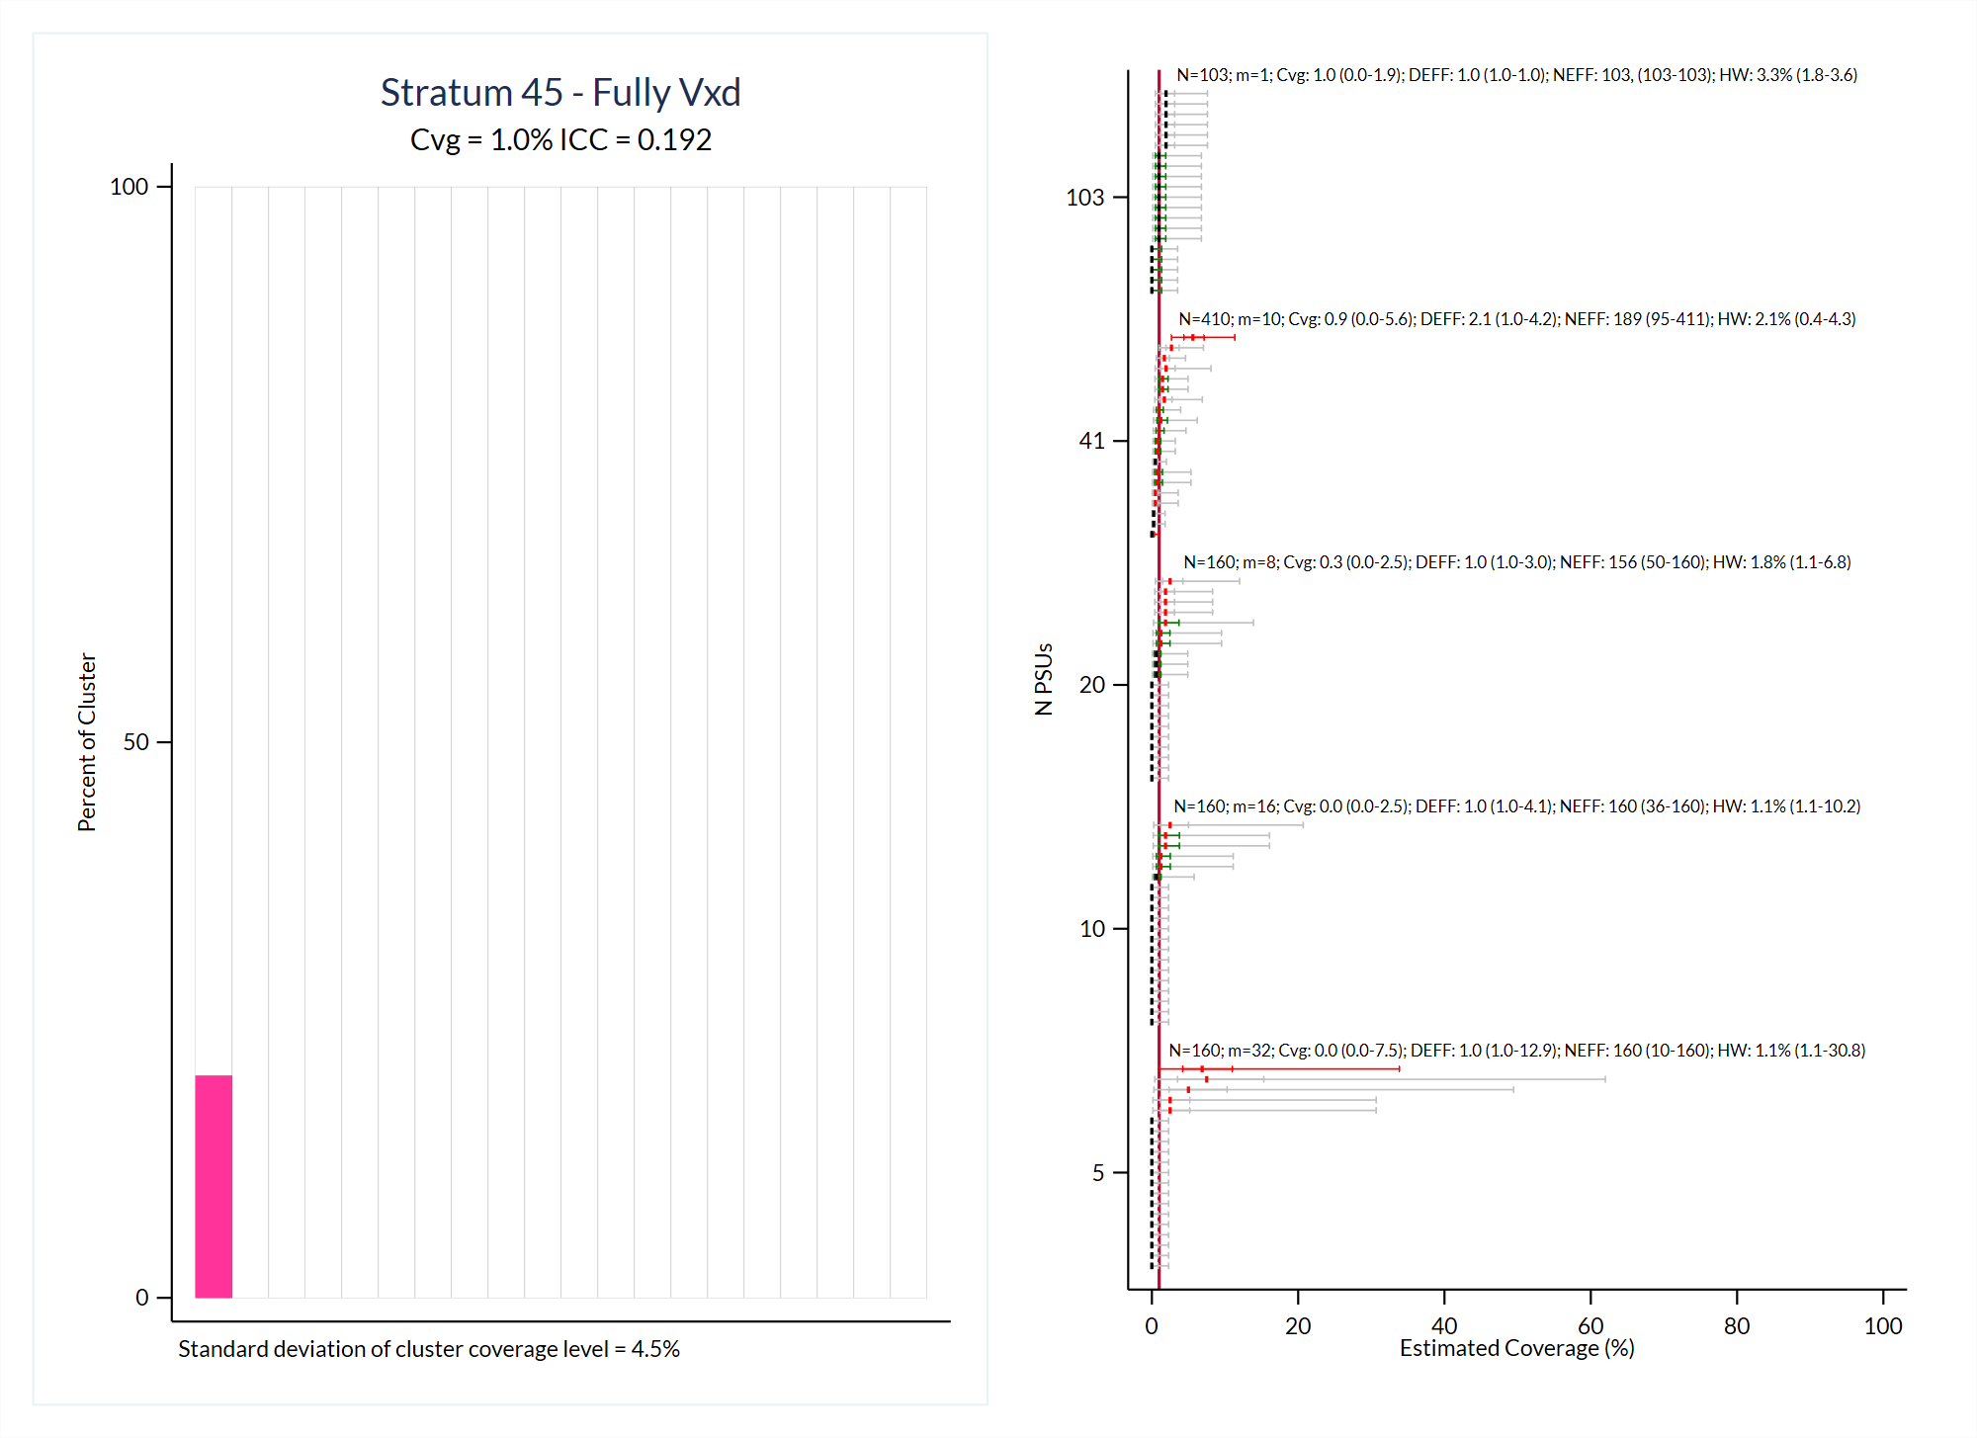

Slide 51
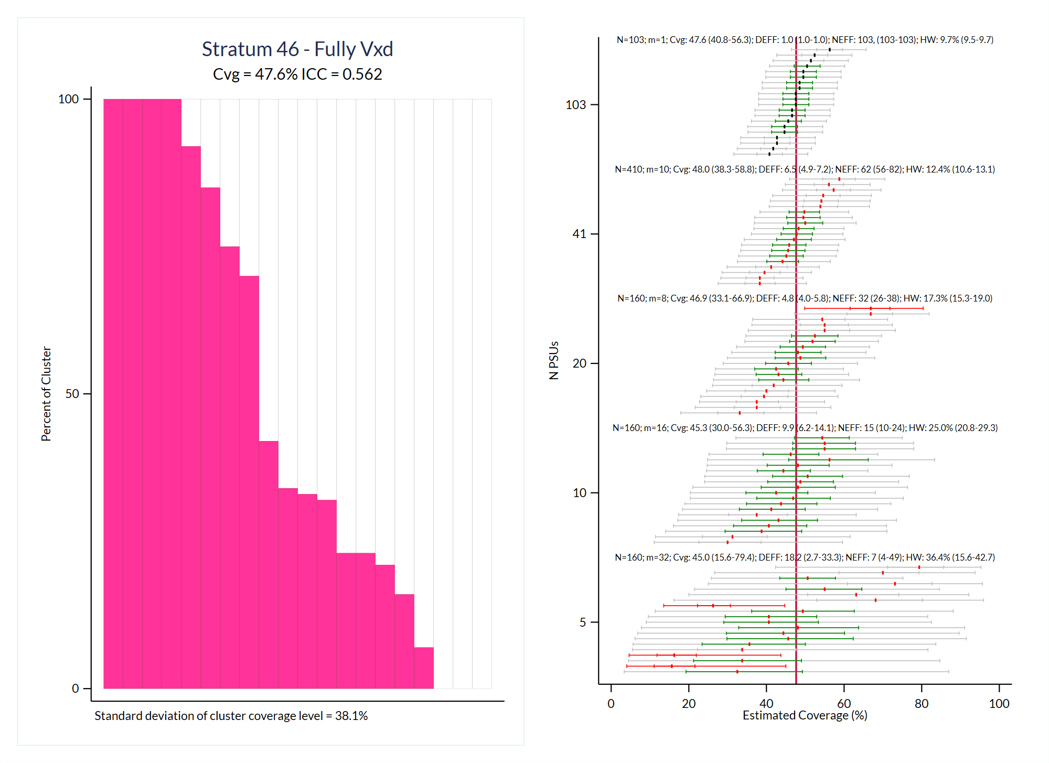

Slide 52
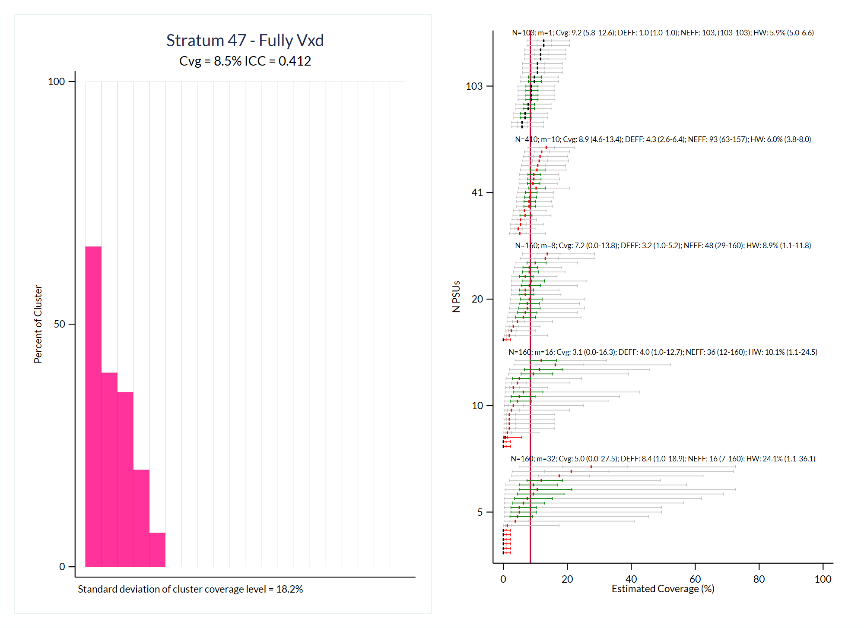

Slide 53
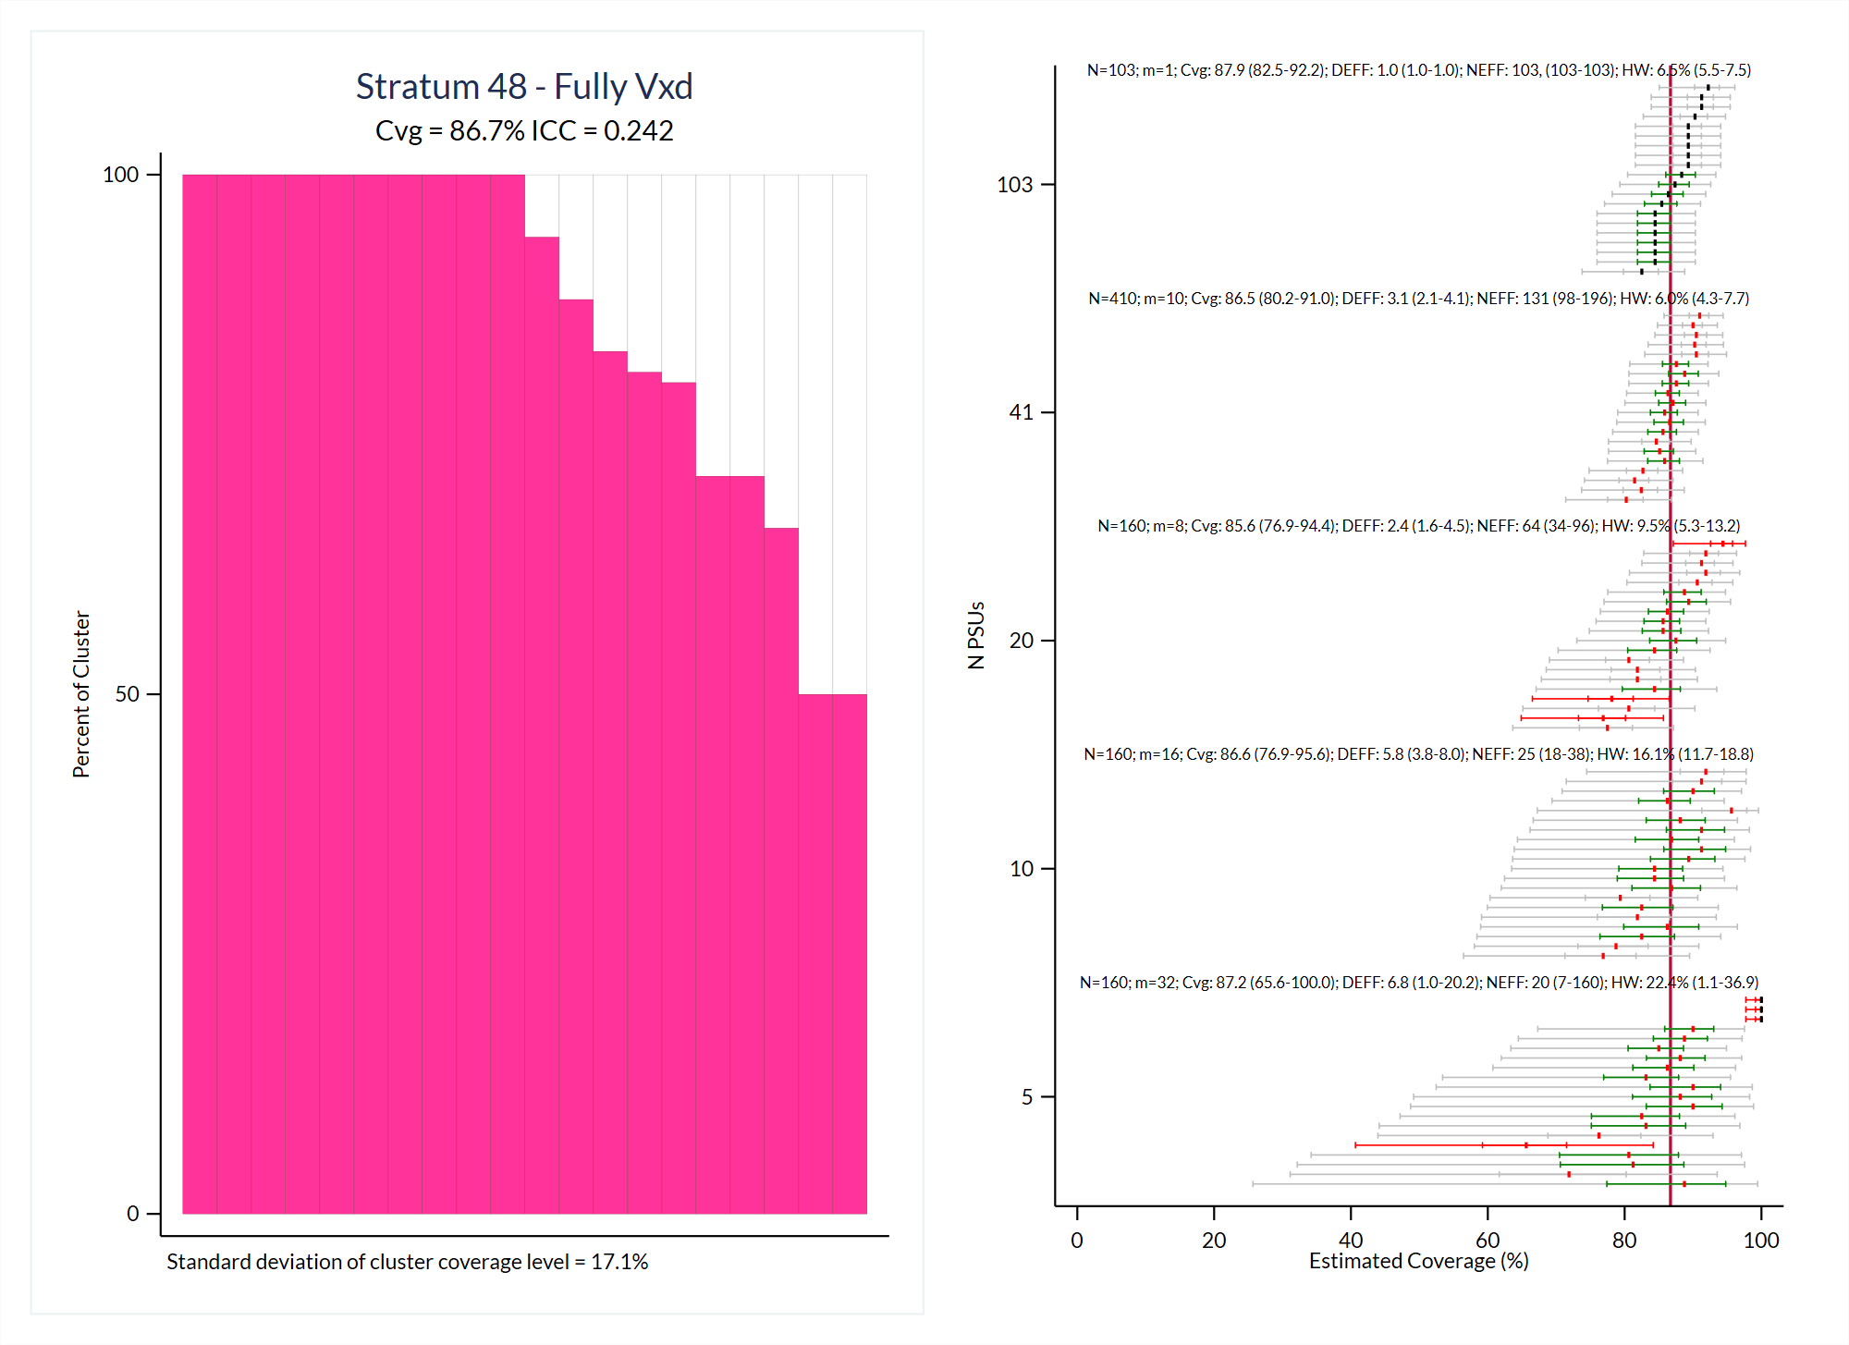

Slide 54
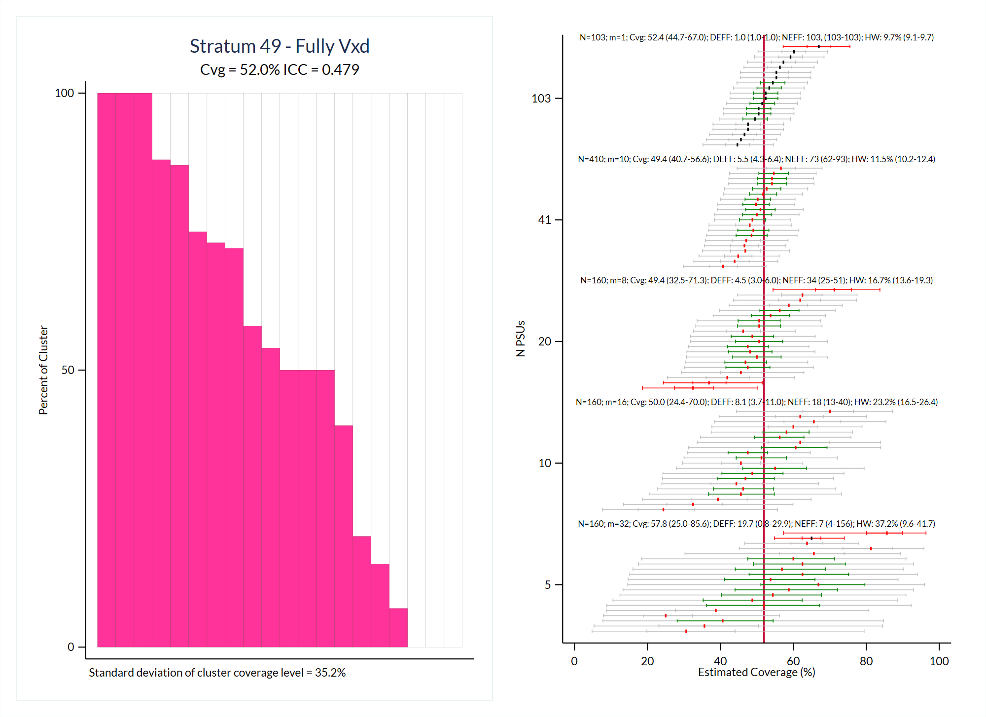

Slide 55
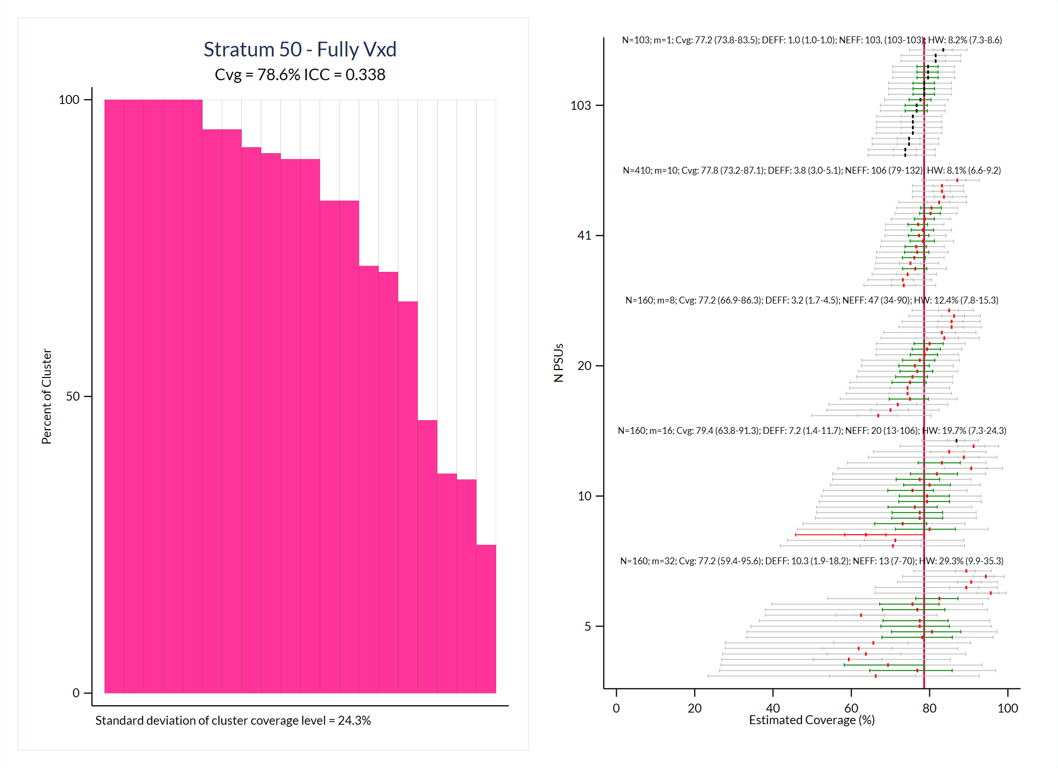

Slide 56


Slide 57


Slide 58


Slide 59


Slide 60


Slide 61


Slide 62


Slide 63


Slide 64


Slide 65


Slide 66


Slide 67


Slide 68


Slide 69
Data from Burkina Faso 2016
The following slides show simulation output for the outcome: Zero Dose
This analysis is unweighted, so these data have been modified slightly to ignore survey weights and to each include 100 faux respondents per cluster. The data used for the simulation looks very much like that in the survey and retains all the important original features.

Slide 70


Slide 71


Slide 72


Slide 73


Slide 74


Slide 75


Slide 76


Slide 77


Slide 78


Slide 79


Slide 80


Slide 81


Slide 82


Slide 83


Slide 84


Slide 85


Slide 86


Slide 87


Slide 88


Slide 89


Slide 90


Slide 91


Slide 92


Slide 93


Slide 94


Slide 95


Slide 96


Slide 97


Slide 98


Slide 99


Slide 100


Slide 101


Slide 102


Slide 103


Slide 104


Slide 105


Slide 106


Slide 107


Slide 108


Slide 109


Slide 110


Slide 111


Slide 112


Slide 113


Slide 114


Slide 115


Slide 116


Slide 117


Slide 118


Slide 119


Slide 120


Slide 121


Slide 122
Data from Pakistan TPVICS Round 2 Survey 2022
The following slides show simulation output for the outcome: Fully Vaccinated Child
This analysis is unweighted, so these data have been modified slightly to ignore survey weights and to each include 100 faux respondents per cluster. The data used for the simulation looks very much like that in the survey and retains all the important original features.

Slide 123


Slide 124


Slide 125


Slide 126


Slide 127


Slide 128


Slide 129


Slide 130


Slide 131


Slide 132


Slide 133


Slide 134


Slide 135


Slide 136


Slide 137


Slide 138


Slide 139


Slide 140


Slide 141


Slide 142


Slide 143


Slide 144


Slide 145


Slide 146


Slide 147


Slide 148


Slide 149


Slide 150


Slide 151


Slide 152


Slide 153


Slide 154


Slide 155


Slide 156


Slide 157


Slide 158


Slide 159


Slide 160


Slide 161


Slide 162


Slide 163


Slide 164


Slide 165


Slide 166


Slide 167


Slide 168


Slide 169


Slide 170


Slide 171


Slide 172


Slide 173


Slide 174


Slide 175


Slide 176


Slide 177


Slide 178


Slide 179


Slide 180


Slide 181


Slide 182


Slide 183


Slide 184


Slide 185


Slide 186


Slide 187


Slide 188


Slide 189


Slide 190


Slide 191


Slide 192


Slide 193


Slide 194


Slide 195


Slide 196


Slide 197


Slide 198


Slide 199


Slide 200


Slide 201


Slide 202


Slide 203


Slide 204


Slide 205


Slide 206


Slide 207


Slide 208


Slide 209


Slide 210


Slide 211


Slide 212


Slide 213


Slide 214


Slide 215


Slide 216


Slide 217


Slide 218


Slide 219


Slide 220


Slide 221


Slide 222


Slide 223


Slide 224


Slide 225


Slide 226


Slide 227


Slide 228


Slide 229


Slide 230


Slide 231


Slide 232


Slide 233


Slide 234


Slide 235


Slide 236


Slide 237


Slide 238


Slide 239


Slide 240


Slide 241


Slide 242


Slide 243


Slide 244


Slide 245


Slide 246


Slide 247


Slide 248


Slide 249


Slide 250


Slide 251


Slide 252


Slide 253


Slide 254


Slide 255


Slide 256


Slide 257


Slide 258


Slide 259


Slide 260


Slide 261


Slide 262


Slide 263


Slide 264


Slide 265


Slide 266


Slide 267


Slide 268


Slide 269


Slide 270


Slide 271


Slide 272


Slide 273


Slide 274


Slide 275
Data from Pakistan TPVICS Round 2 Survey 2022
The following slides show simulation output for the outcome: Zero Dose
This analysis is unweighted, so these data have been modified slightly to ignore survey weights and to each include 100 faux respondents per cluster. The data used for the simulation looks very much like that in the survey and retains all the important original features.

Slide 276


Slide 277


Slide 278


Slide 279


Slide 280


Slide 281


Slide 282


Slide 283


Slide 284


Slide 285


Slide 286


Slide 287


Slide 288


Slide 289


Slide 290


Slide 291


Slide 292


Slide 293


Slide 294


Slide 295


Slide 296


Slide 297


Slide 298


Slide 299


Slide 300


Slide 301


Slide 302


Slide 303


Slide 304


Slide 305


Slide 306


Slide 307


Slide 308


Slide 309


Slide 310


Slide 311


Slide 312


Slide 313


Slide 314


Slide 315


Slide 316


Slide 317


Slide 318


Slide 319


Slide 320


Slide 321


Slide 322


Slide 323


Slide 324


Slide 325


Slide 326


Slide 327


Slide 328


Slide 329


Slide 330


Slide 331


Slide 332


Slide 333


Slide 334


Slide 335


Slide 336


Slide 337


Slide 338


Slide 339


Slide 340


Slide 341


Slide 342


Slide 343


Slide 344


Slide 345


Slide 346


Slide 347


Slide 348


Slide 349


Slide 350


Slide 351


Slide 352


Slide 353


Slide 354


Slide 355


Slide 356


Slide 357


Slide 358


Slide 359


Slide 360


Slide 361


Slide 362


Slide 363


Slide 364


Slide 365


Slide 366


Slide 367


Slide 368


Slide 369


Slide 370


Slide 371


Slide 372


Slide 373


Slide 374


Slide 375


Slide 376


Slide 377


Slide 378


Slide 379


Slide 380


Slide 381


Slide 382


Slide 383


Slide 384


Slide 385


Slide 386


Slide 387


Slide 388


Slide 389


Slide 390


Slide 391


Slide 392


Slide 393


Slide 394


Slide 395


Slide 396


Slide 397


Slide 398


Slide 399


Slide 400


Slide 401

Dale.Rhoda@biostatglobal.com
www.biostatglobal.com
+1 (614) 499-2351 (Mobile / WhatsApp)

